Slide 1
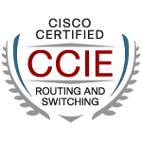
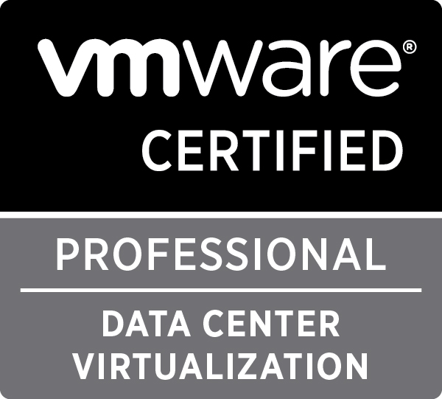
Revolutionizing Data Centers with SimpliVity
Adam Marcinkowski
Solutions Architect Eastern Europe
4th November 2015

Slide 2
Economic Dynamics are Changing
CAGR
Cisco UCS:
40+%
55
Converged Infrastructure:
54.7%
40
25
10
Storage: 4.1%
2
Server: 0.3%
0
2011
2012
2013
2014
2015
2016
Source: IDC, Gartner

Slide 3
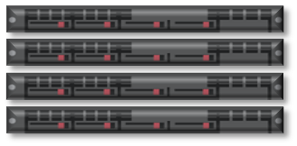
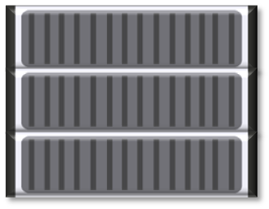
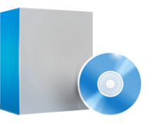
Vision
Orchestration
Legacy IT Infrastructure
The Cisco Hyperconverged Future Is Now
Management
Hypervisor
All IT infrastructure
below the hypervisor
Servers
Storage switch
Deployed Anywhere
HA shared storage
Will run on Cisco UCS
SSD array
Backup appliance
Powered by
WAN optimization
Cloud gateway
Storage caching
Data Protection Apps
OmniStack™
& Data Virtualization Platform™

Slide 4
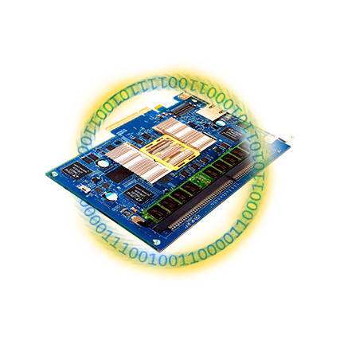
SimpliVity’s Architecture: Data Virtualization Platform
Accelerated Data Efficiency
Global Unified Management
Built-in Data Protection
VM Centricity & Mobility
Global Federation
Single Pane of Glass
VMware vCenter
One Administrator, Globally
Abstract Policy from Underlying Infrastructure
Integration with Cisco UCS Director and UCS Manager
Single Shared Scale-Out Resource Pool
Dedupe, Compress, Optimize
At Inception, Once and Forever
Across All Tiers, Globally
Powered by OmniStack Accelerator Card
Backup at 10-minute RPOs
Restore at RTOs in seconds
Synchronous replication for HA, locally or remote (stretch cluster)
Disaster Recovery
Full Logical, no more snaps
Manual or Automatic

Slide 5
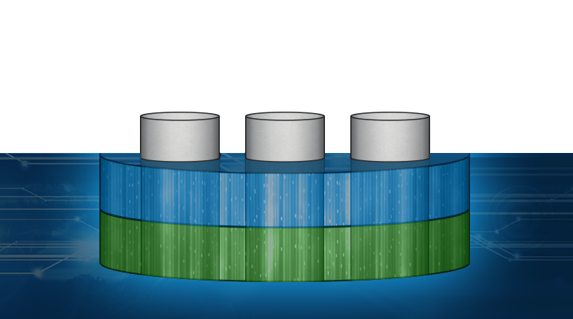
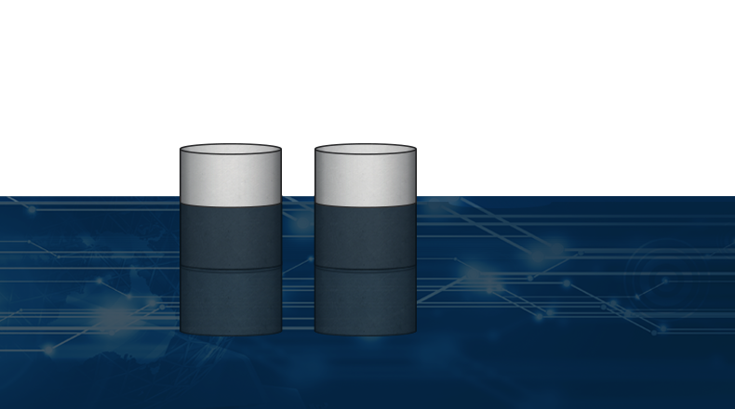
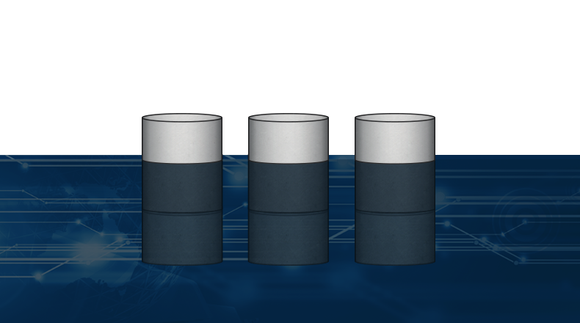
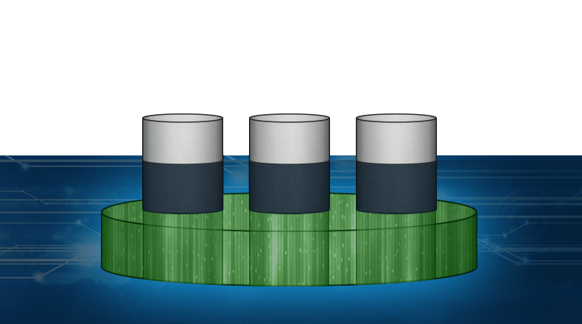
Data Virtualization Platform (DVP) Architecture
Management Choice
Native VM Tools, Orchestration & Automation, REST
Server and OS Virtualization Choice
OMNISTACK DATA VIRTUALIZATION PLATFORM
z
DVP Foundation
DVP Foundation
DVP Foundation
DVP Foundation
DVP Foundation
Accelerated
Data Efficiency
Accelerated
Data Efficiency
Accelerated
Data Efficiency
Accelerated
Data Efficiency
Accelerated
Data Efficiency
Global Unified
Management
Global Unified
Management
Global Unified
Management
Global Unified
Management
Built-in Data
Protection
Built-in Data
Protection
Built-in Data
Protection
SimpliVity File System
SimpliVity Object Store
SimpliVity Object Store
x86 Choice
Cloud Choice
Any Server
Regional Service Providers

Slide 6
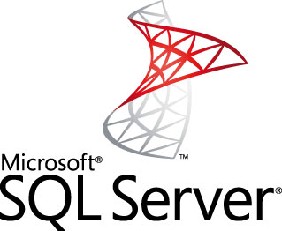
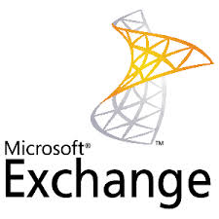
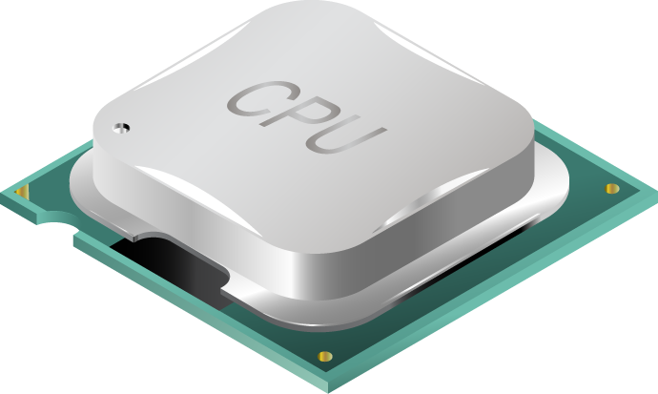
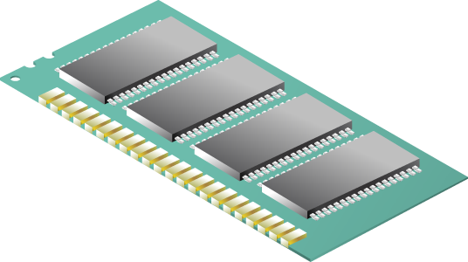
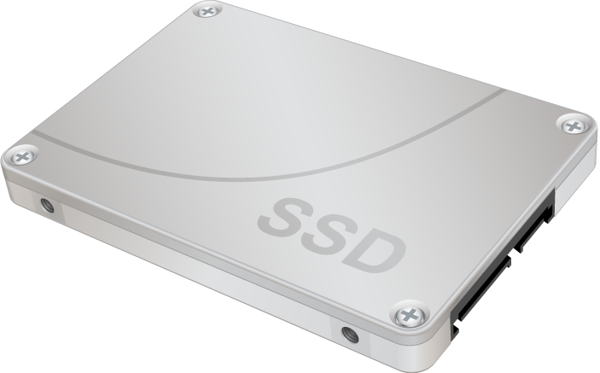
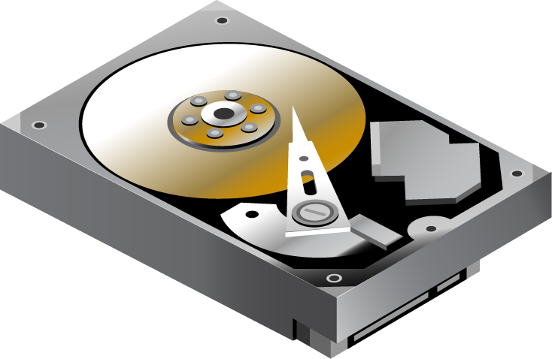
SimpliVity’s Data Virtualization Platform
New Write
App 3
App 4
Deduped Write
New Write
New Write
Deduped Write
ESXi
PRESENTATION LAYER
DATA MANAGEMENT LAYER
DATA VIRTUALIZATION PLATFORM
X86 CPU
ALL DATA WRITTEN/REGISTERED TO VIRTUALIZATION PLATFORM
DRAM
SSD
ONLY UNIQUE DATA WRITTEN TO HDD
HDD

Slide 7
SimpliVity’s Data Virtualization Platform
App 3
App 4
ESXi
PRESENTATION LAYER
DATA MANAGEMENT LAYER
X86 CPU
DRAM
SSD
HDD
Notes:
OmniStack Acclerator PCIe Card
Hardware accelerated inline dedupe, compression, optimization
High Performance, Wire Speed
Application to Data Affinity
Dramatic Latency Improvement
Increases Cache/SSD Efficiency
Radically Reduces IO

Slide 8
SimpliVity’s Data Virtualization Platform
App 3
App 4
ESXi
PRESENTATION LAYER
DATA MANAGEMENT LAYER
X86 CPU
DRAM
SSD
HDD
Notes:
OmniStack Acclerator PCIe Card
Hardware accelerated inline dedupe, compression, optimization
High Performance, Wire Speed
Application to Data Affinity
Dramatic Latency Improvement
Increases Cache/SSD Efficiency
Radically Reduces IO

Slide 9
Native Data Protection
Fast Application Restore from Full VM Backup
App 3
App 4
App 5
ESXi
ESXi
PRESENTATION LAYER
PRESENTATION LAYER
DATA MANAGEMENT LAYER
DATA MANAGEMENT LAYER
Local, Full VM Backup
Remote Full VM Backup
X86 CPU
DRAM
SSD
HDD
All data is deduplicated and compressed to minimize data flow across geography
New York
San Francisco

Slide 10
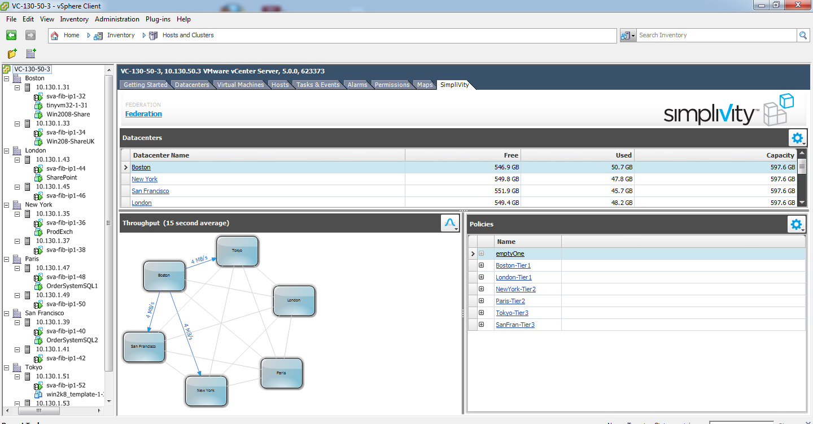
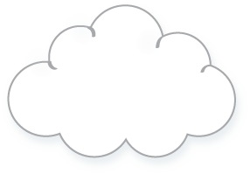
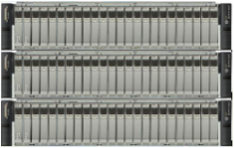
Global Unified Management from Single Pane of Glass: VMware vCenter
PRESENTATION LAYER
PRESENTATION LAYER
DATA MANAGEMENT LAYER
DATA MANAGEMENT LAYER
Public Cloud
SVT
New York
Las Vegas

Slide 11
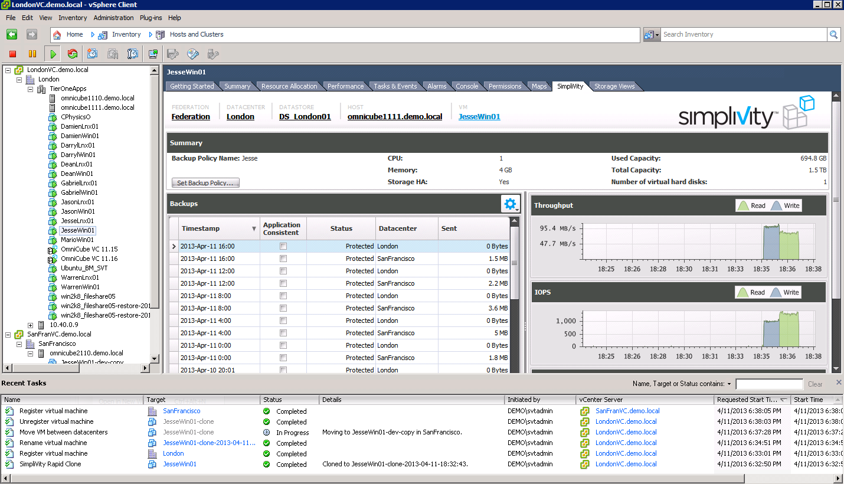
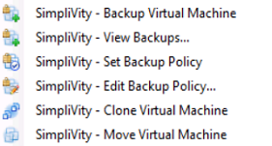
VM-Centricity Of All Operations for IT
Alignment of Data to VM’s – Single Pane of Glass
Solve the IO and Data Mobility by only transferring unique data globally at At VM-level granularity
VM centricity of all operations
Backup
Clone
Move
Restore
Easy to create workflows for protecting, restoring, creating multiple production Dev/test copies, recovering to DR.

Slide 12
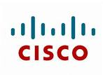
Scale-Out and Open Architecture
Servers
VM
VM
VM
VM
VM
ESXi
VM
VM
VM
VM
VM
VM
VM
VM
VM
VM
VM
VM
VM
VM
VM
VM
SVT
SVT
VM
SVT
VM
VM
SVT
VM
VM
ESXi
ESXi
ESXi
ESXi
ESXi
SSD
SSD
SSD
SSD
SSD
SSD
SSD
SSD
10GbE
Public Cloud
SVT

Slide 13
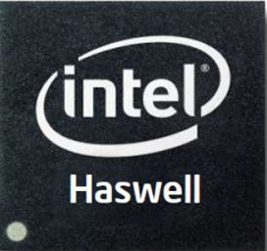
OmniStack Solution with Cisco UCS
With SimpliVity’s OmniStack
Accelerator
Card
Small to Medium Environments and Remote Offices
Wide range of use cases, optimized for Core Applications
Wide range of use cases, optimized for Core Applications
Optimized for highest performance Application workloads
C240 M4SX
C240 M3SX
C240 M4SX
C240 M4SX
CPU
8 – 28 cores
8 - 24 cores
16 - 28 cores
16 - 28 cores
Memory*
50 – 710 GB
139 – 651 GB
155 – 667 GB
155 – 667 GB
Capacity*
5 - 10TB
12 – 25 TB
18 – 36 TB
20 – 40 TB
Storage Configuration
2 x 400GB SSD,
8 x 1TB HDD
6 x 400GB SSD,
18 x 1TB HDD
4 x 400GB SSD,
20 x 1TB HDD
4 x 400GB SSD,
20 x 1.2TB HDD
Size
2RU
2RU
2RU
2RU
Enterprise
Capabilities
Global Dedupe, Compression, Optimization, High Availability, Redundant Power, VM-Centric policy-based Backup/Recovery/DR, Replication, VM Mobility, Integrated Management via vCenter and UCS Director
* usable
Notes:
Script:
SimpliVity’s OmniStack solution is all about choice. That’s why we offer our technology in partnership with several x86 vendors, including Cisco.

Slide 14
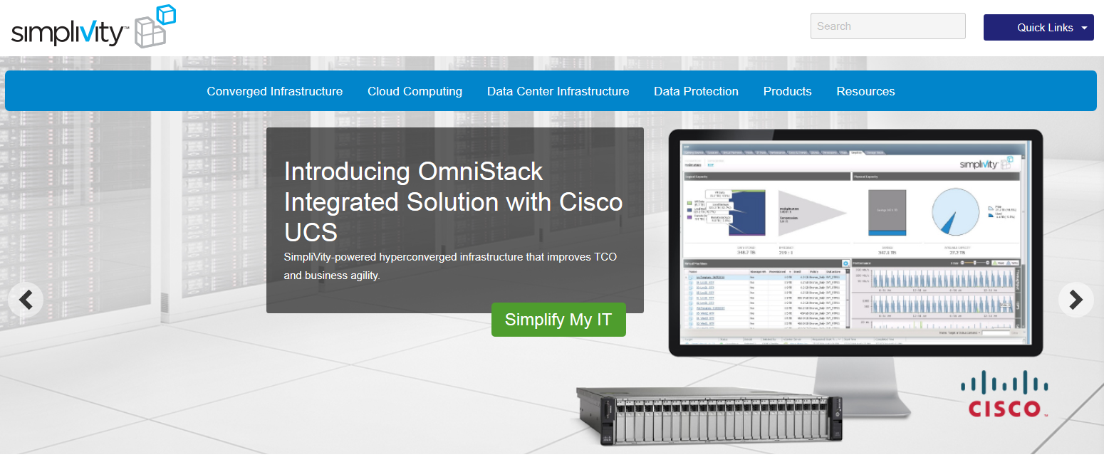
Learn More: Cisco.com and SimpliVity.com

Slide 15
Cisco Solutions Catalogue
“The Cisco Compatible logo is used to signify that the PARTNER product has undergone technical interoperability testing with the Cisco product specified.”
Notes:
https://marketplace.cisco.com/catalog/products/2143

Slide 16
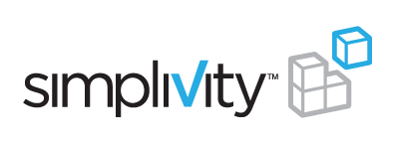
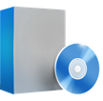
Evolution of Convergence
8 MONTHS in development
18 MONTHS in development
43 MONTHS in development
Legacy Stack
Convergence 1.0
Integrated Systems
Convergence 2.0
Partial Convergence
Convergence 3.0
Hyperconvergence
Servers + VMware
Storage Switch
HA Shared Storage
SSD Array
Backup Appliance
WAN Optimization
Cloud Gateway
Storage Caching
Backup Apps
Pre-integrated storage and server
Converge only
storage and server
Hyperconverge
entire stack
Enterprise Capabilities
Cloud Economics
Data Protection
Data Efficiency
Performance
Global Unified Management
Low Cost
x86 Resources
Scale-out
The Best of
Both Worlds
Notes:
Now, there are a lot of vendors out there talking about convergence.
Let’s take a little trip down memory lane to explain the differences.
Click:
In 2009, some of the integrated systems and reference architectures started being built. These are the VCE and FlexPods of the world. We give them a lot of credit for kickstarting this industry and they have some benefit around faster time to deployment. But, we contest that they did nothing to fundamentally change the data architecture. They took existing legacy products and wrapped a management interface around it. They also only focused on the top half of the stack: servers and storage.
Notice that they only spent about 8 months in development before the first product went GA.
Click:
At around the same time, convergence 2.0 companies like Nutanix also came to market. There’s some good innovation here as they took servers and storage and redesigned them to create a single shared resource pool, mostly for VDI.
There are definitely some benefits, but we argue they’re missing the full story. They stopped at server and storage and didn’t innovate below the line. No deduplication, compression and optimization. No global unified management. No integrated data protection at the VM level.
Click:
True innovation comes with a lot of R&D and a lot of time invested. SimpliVity invested 3.5 years in stealth developing the industry’s only truly hyperconverged product. The only product that provides a single shared resource pool across the entire legacy stack.
We often use this metaphor: if you’re backing a cake, you have to do everything by design, up-front. If you take the cake out of the oven, and then realize you forgot an egg, it’s too late. You physically cannot get that egg into that cake without starting from scratch. This applies perfectly to SimpliVity. We baked the egg in the cake, and it’s why we have deduplication compression and optimization for all data, inline, in real-time at inception once and forever, and others are trying to catch up.
Click:
The integrated systems vendors provide enterprise capabilities
Click:
The convergence 2.0 vendors provide some cloud economics
Click:
And SimpliVity is the only one providing the best of both worlds

Slide 17
Customer Validation

Slide 18
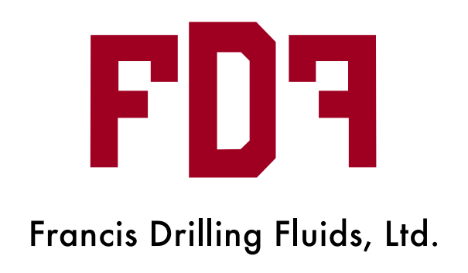
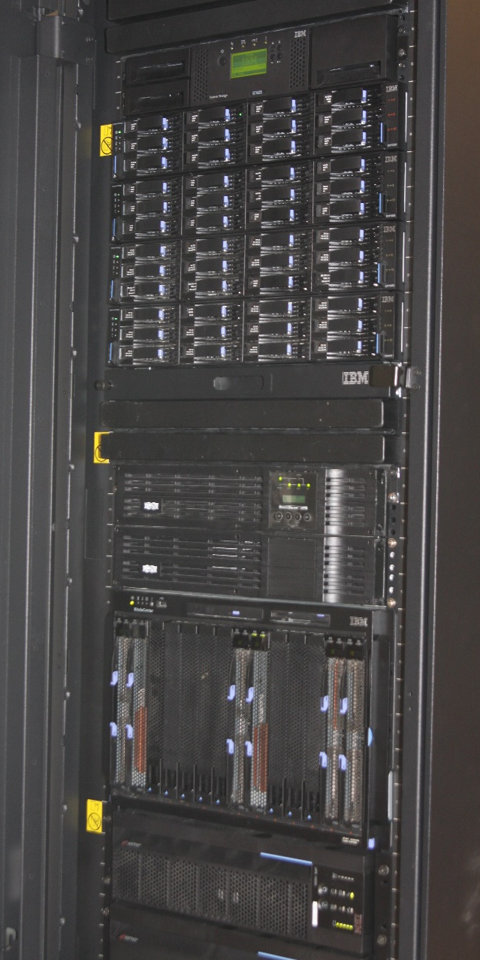
SimpliVity Reduced Infrastructure Footprint by 5X
IBM Tape Library
IBM Storage Array
Before:
20U; No DR
~60 VMs
After:
4U x 2 Sites
~60 VMs + DR
2 OmniCubes in Lafayette, LA; 2 OmniCubes in Dallas, TX
IBM Blade Server
&
IBM SAN
“OmniCube allowed us to radically simplify our infrastructure. The solution provides superior value and innovation in a converged solution.”
—Steve Schaaf, CIO

Slide 19
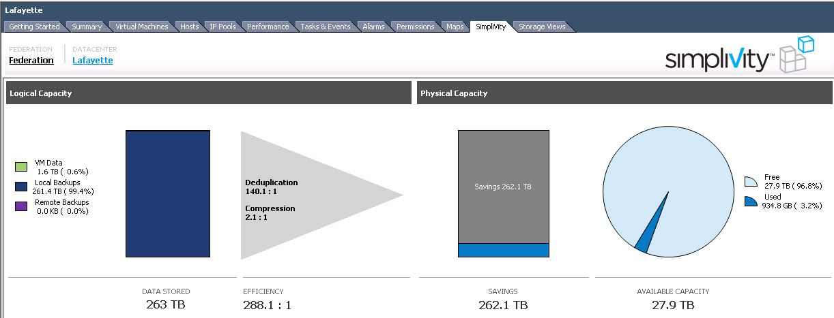
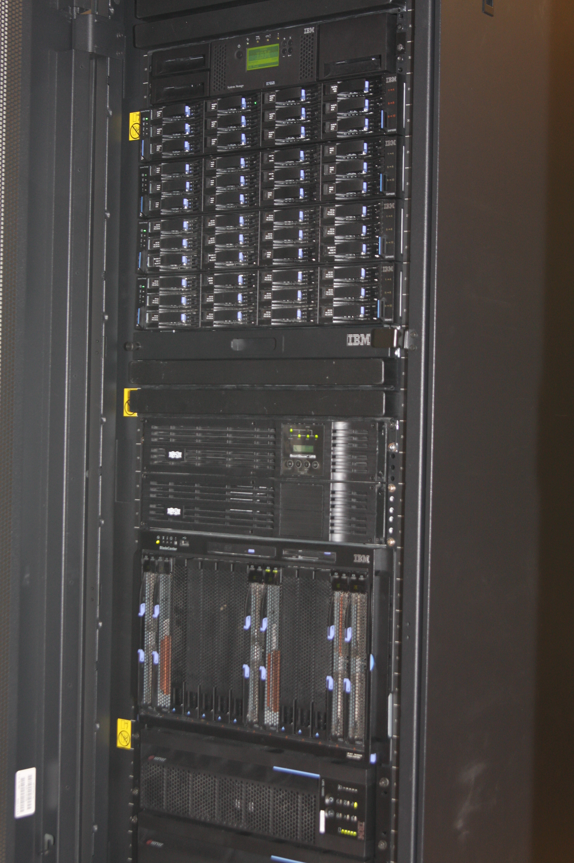
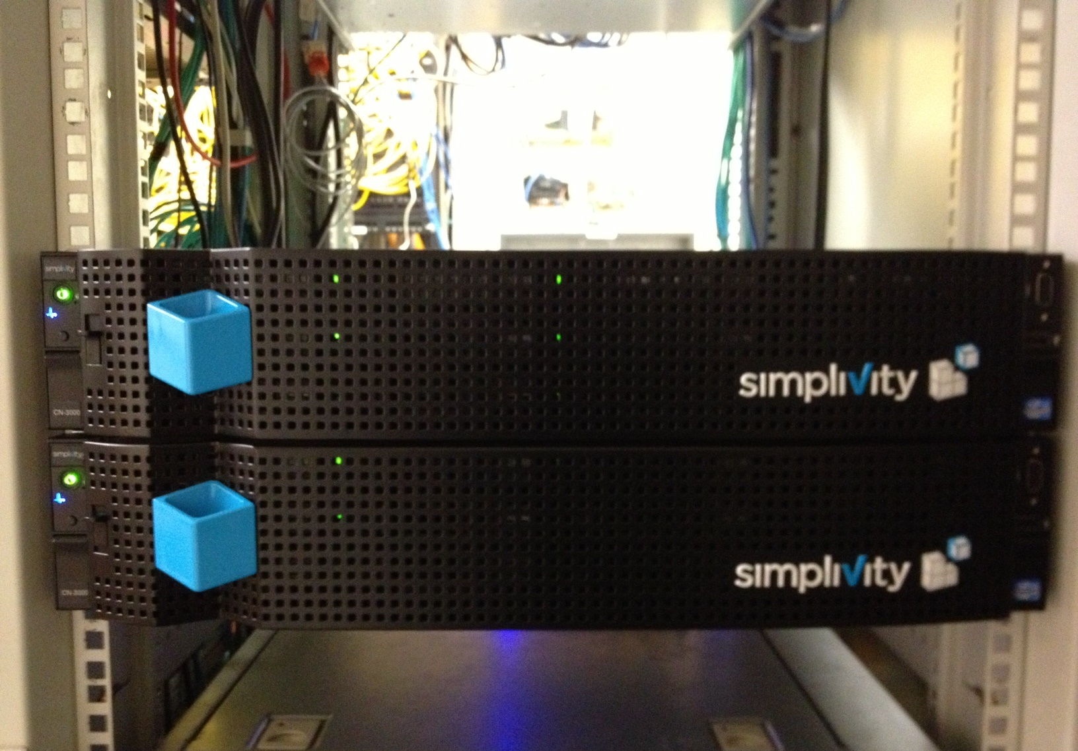
Francis Drilling Fluids, Ltd. – Mid-sized Oil & Gas Supplier Data Center View: 262 TB Savings
Logical Capacity for 26 VMs
Mixed Workloads: MSFT Dynamics, Exchange, SQL Server, Active Directory, Kofax/Axacore, NetTraQ GPS
VM-level Backups using Policy Automation (Nightly)
Before
20U
After
4U

Slide 20
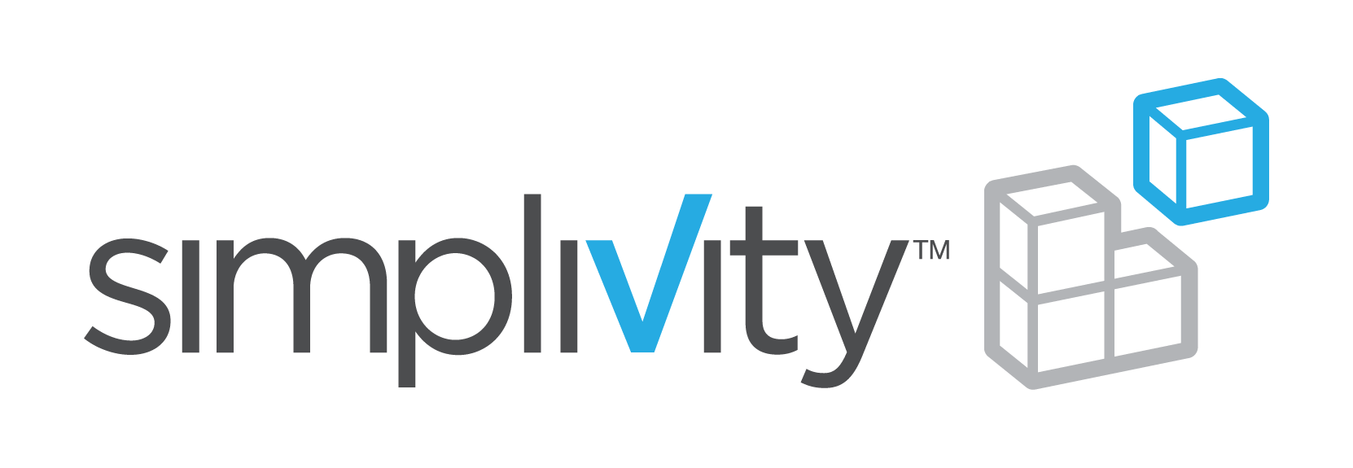
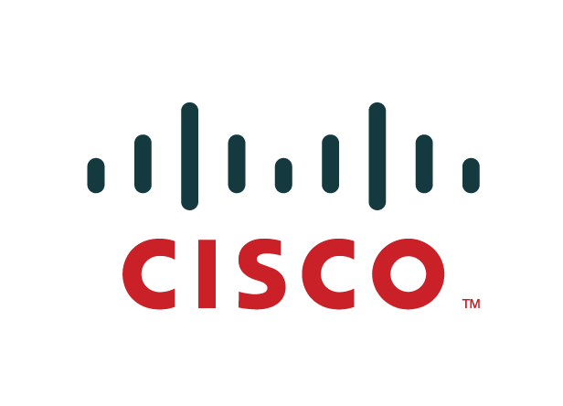
Virtualize your data, network, and servers
Virtualize your servers
Virtualize your
Data
Virtualize your network

Slide 21
Demo

