Slide 1
Gain Operational Excellence with
Hyperconverged Architecture in Data Cente
Dariusz Chwiejczak, Director Eastern Europe
4 November 2015

Slide 2
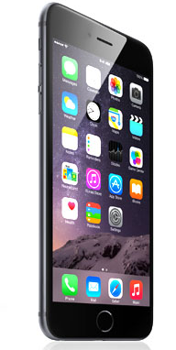
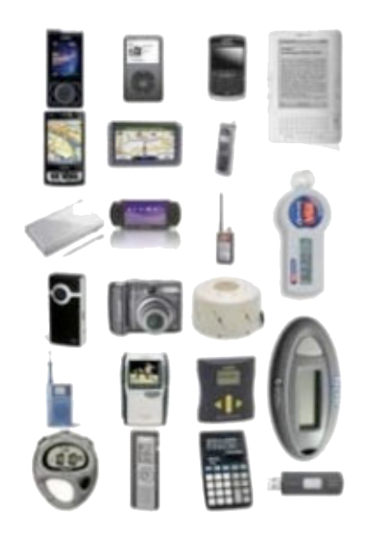
What is Hyperconvergence ?
VS

Slide 3
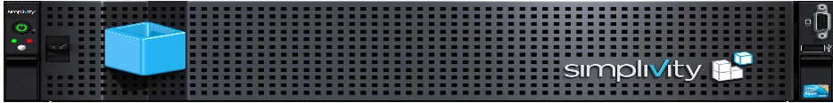
What is Hyperconvergence ?
Faster Operations
Consolidated infrastructure
Application performance
VDI
DR
Improved SLA
Back up
Cloud
Scale-out
High Availability
WAN optimization ROBO
Consolidated management
Deduplication Compression

Slide 4
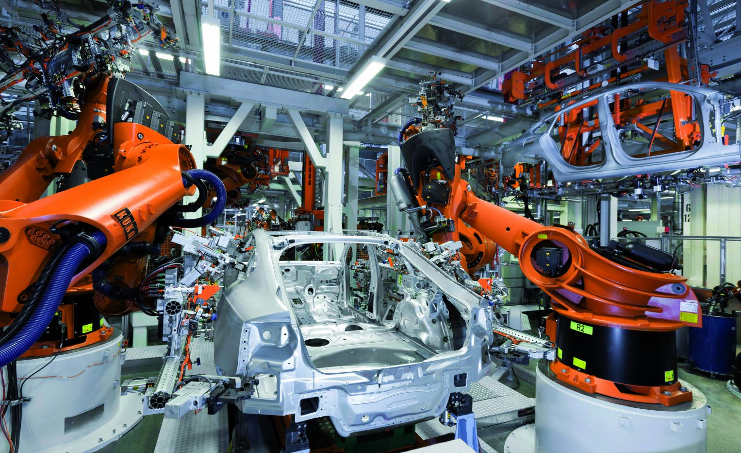
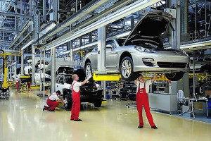
Manufacturing Plant vs. IT Data Center
higher flexibility, higher agility - but with less costs
Technical Innovations
Lean Management
Higher Automation Level
Les Labor intensive
More flexible in responding to business requirements
Shift of resources to focus on innovations and SLA

Slide 5
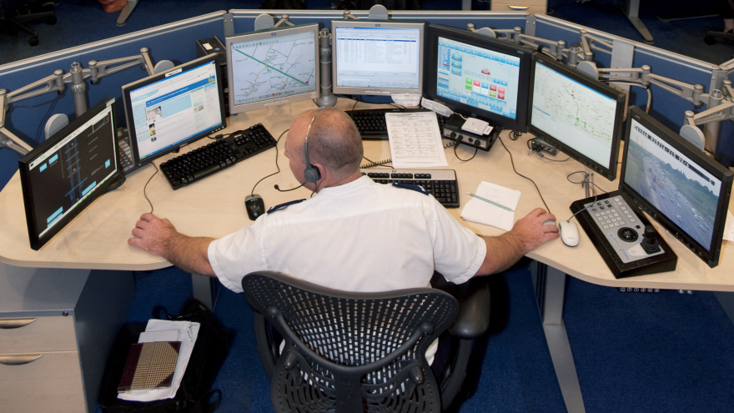
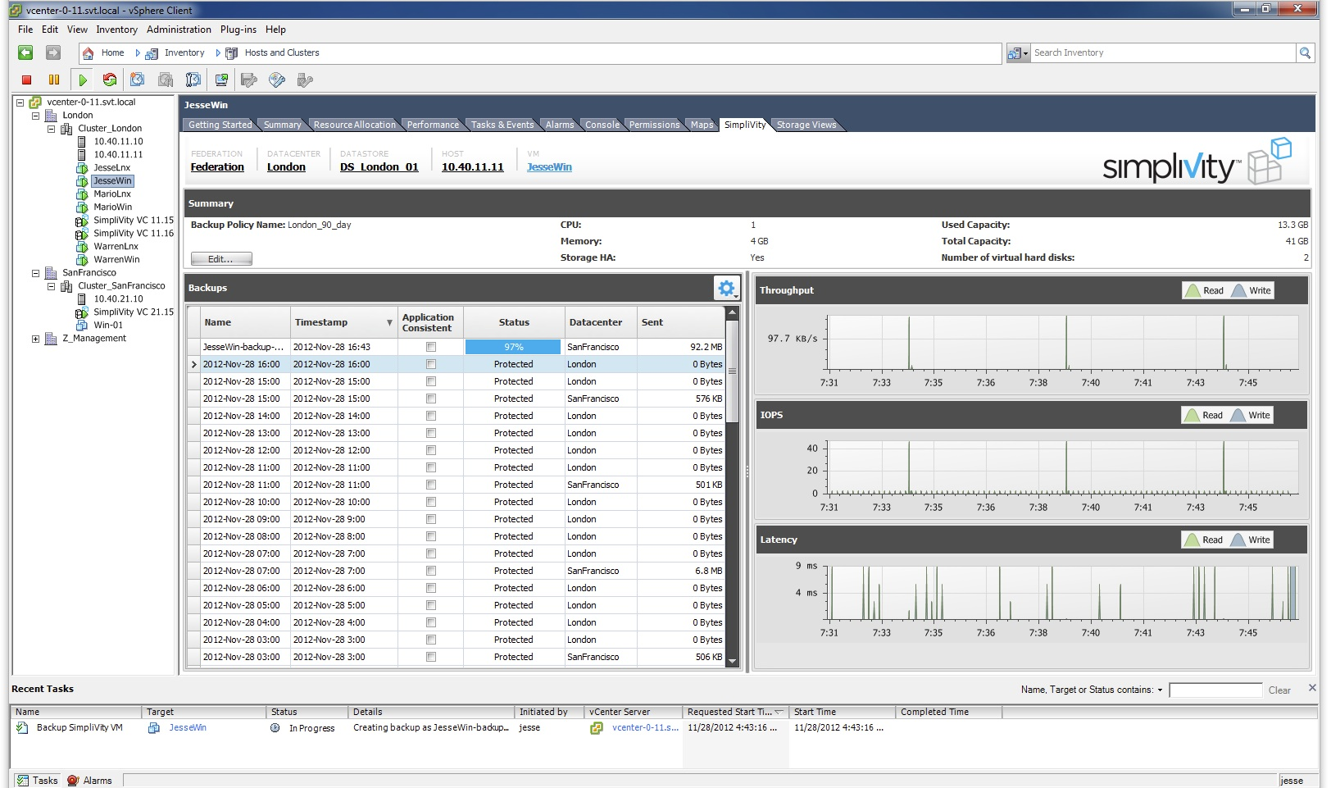
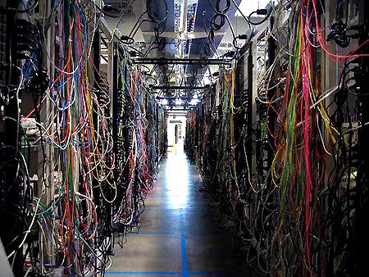
Hyperconvergence = Simplify Your IT
Transform Complexity
into Turnkey Simplicity
One Screen
One Platform
Manage More - Store More - Transfer More - Protect More.

Slide 6
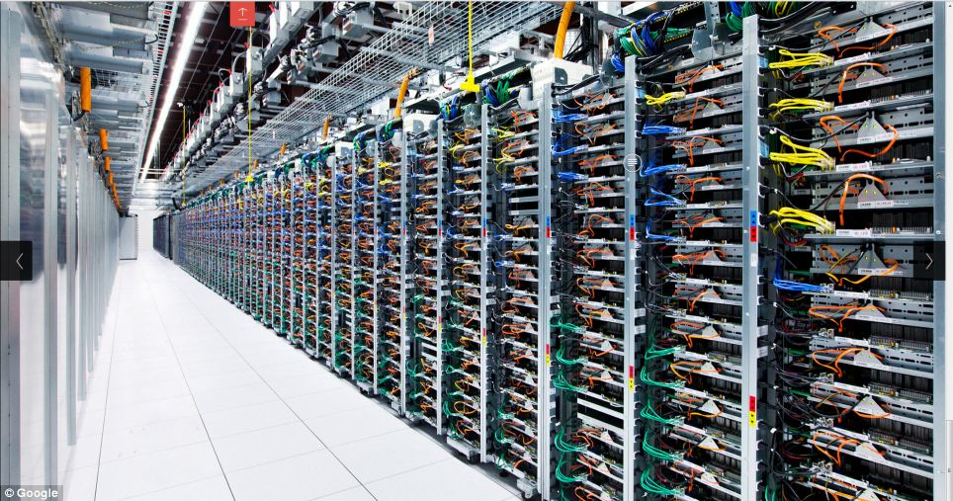
Facebook DC – Converged Architecture Cloud Economics

Slide 7
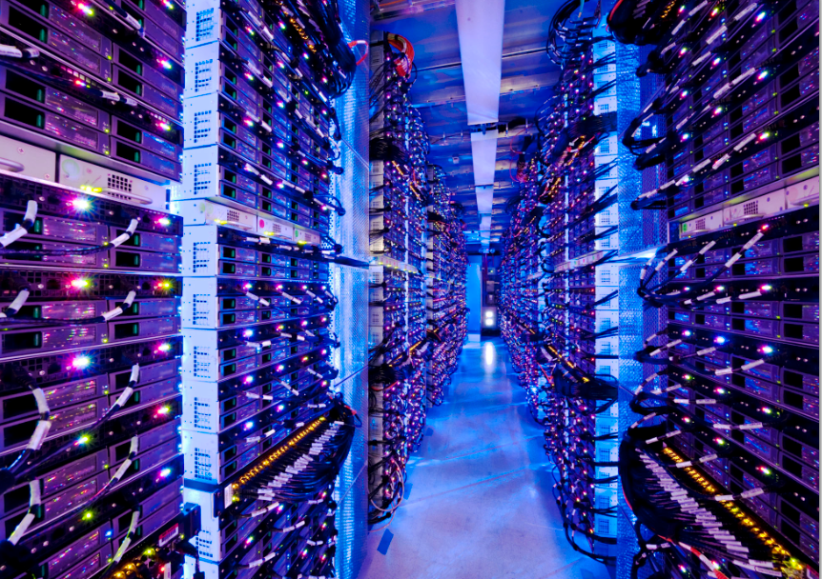
Google DC – Converged Architecture Cloud Economics

Slide 8
Converged Data Center is Today’s Market Reality
CAGR
Converged
55
Cisco UCS:
40+%
Available from
HP
Dell
Cisco
Fujtsu
EMC
NOT PROMOTED !
40
25
Storage
10
Storage: 4.1%
2
Server
0
2011
2012
2013
2014
2015
2016
Source: IDC, Gartner

Slide 9


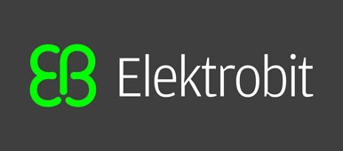
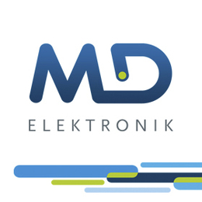

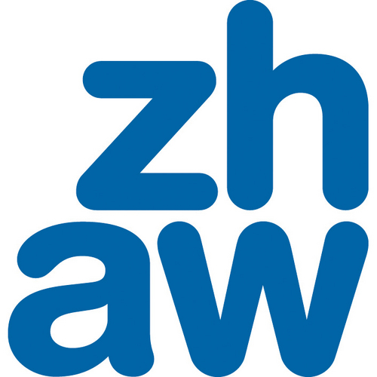


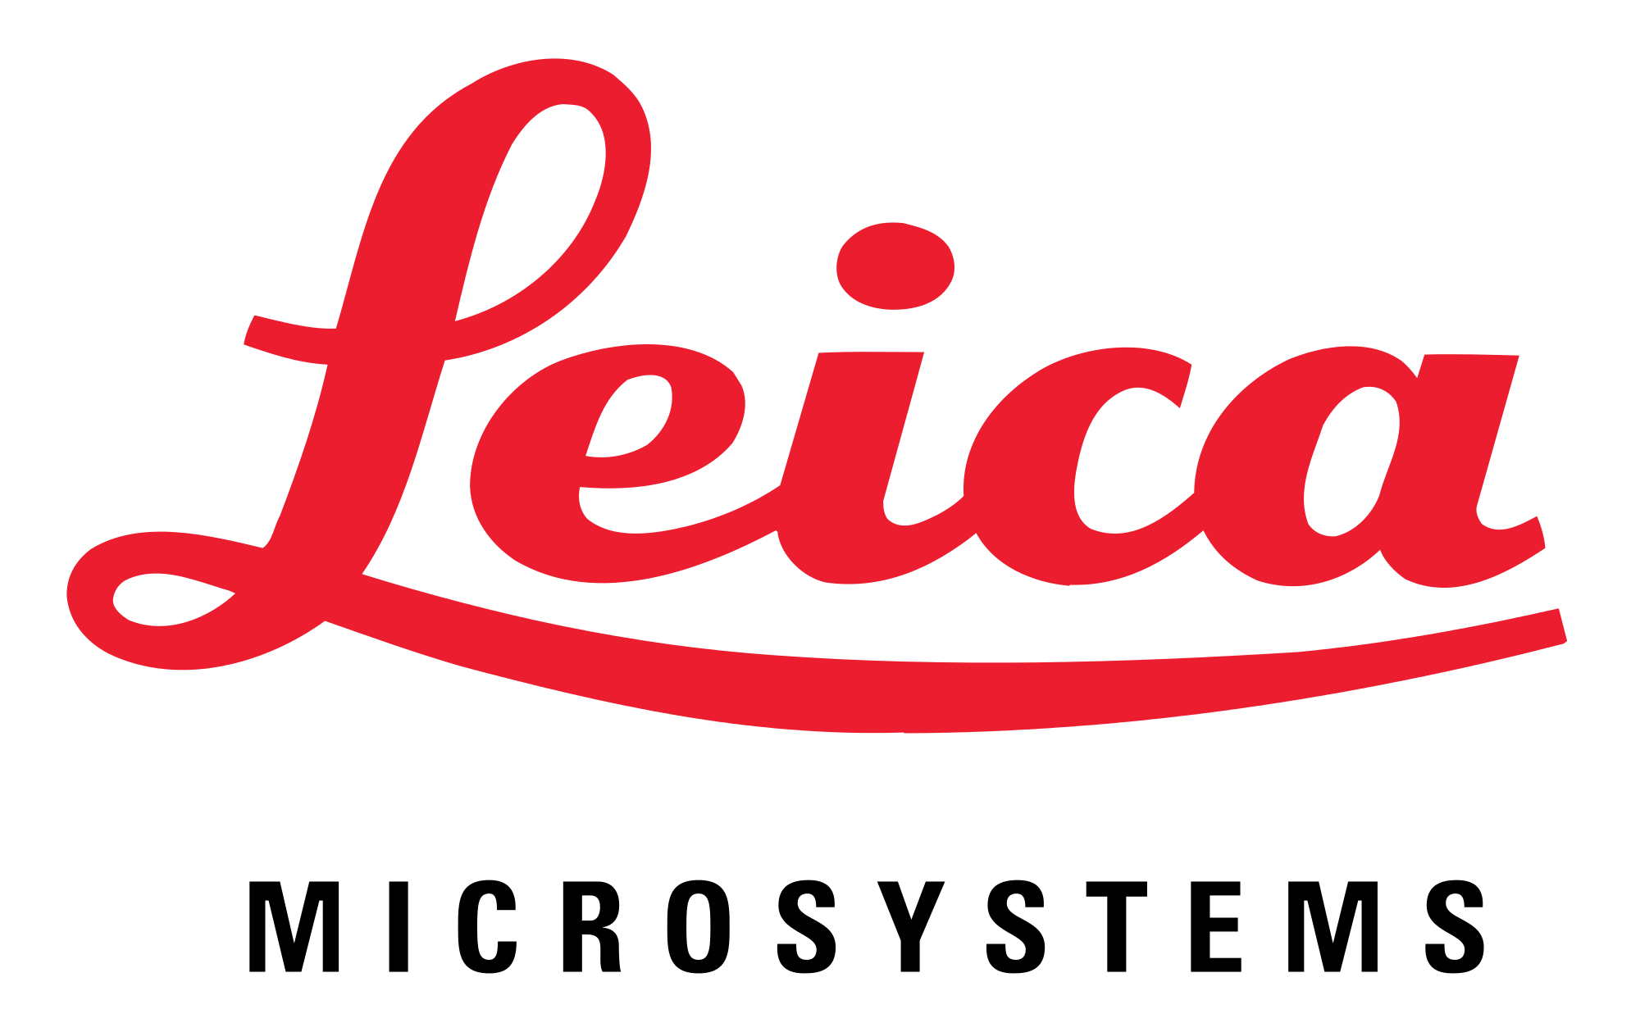
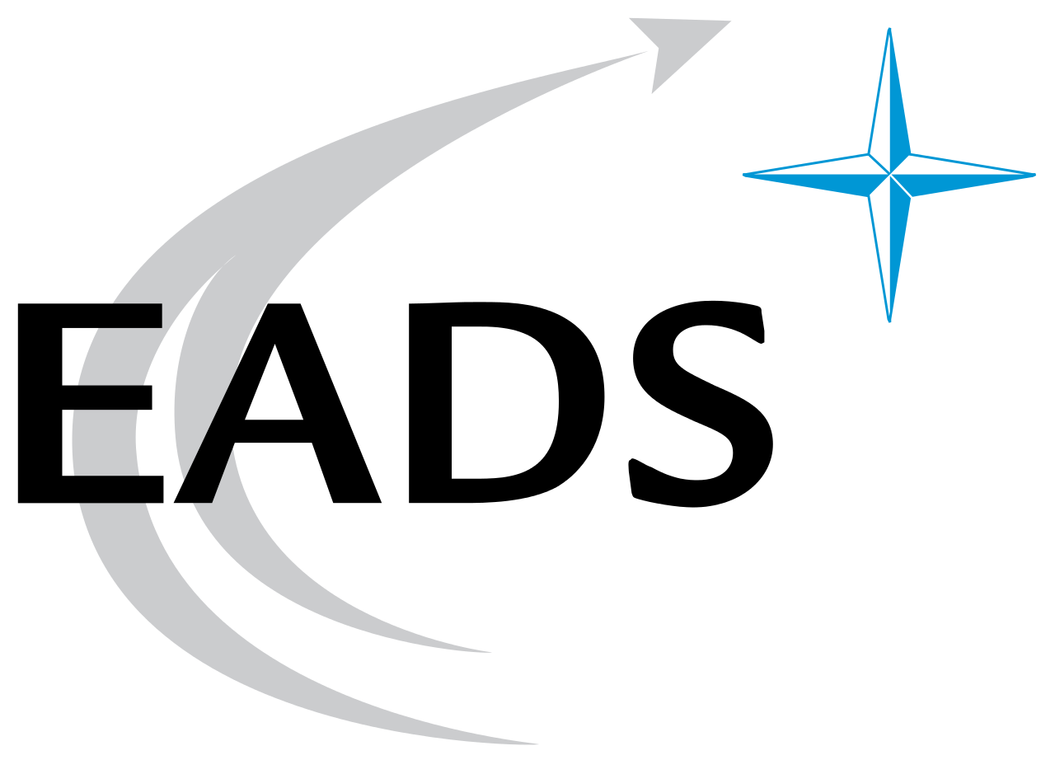






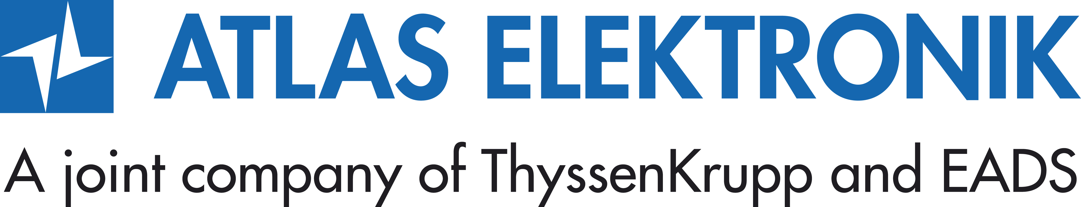
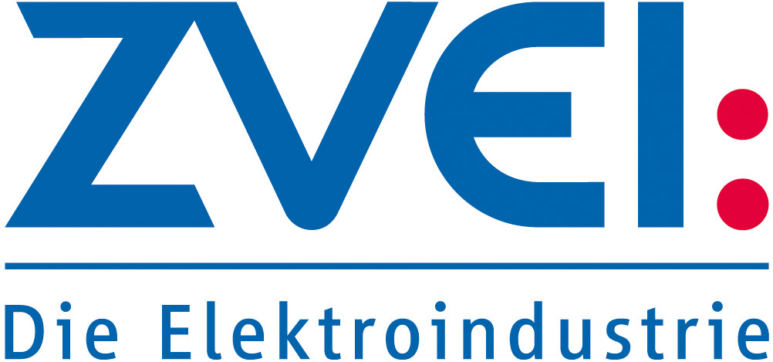







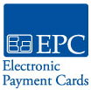
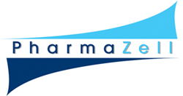










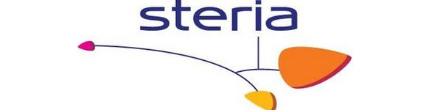
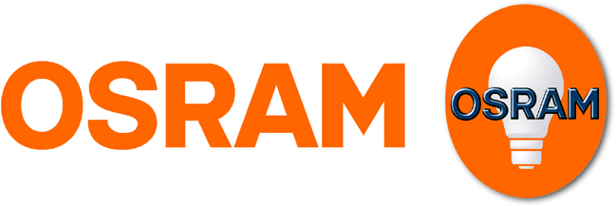

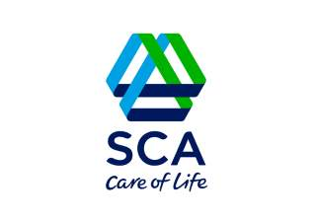


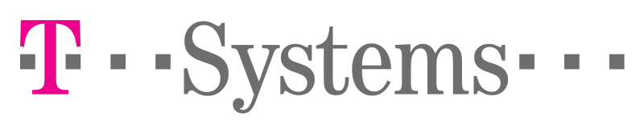
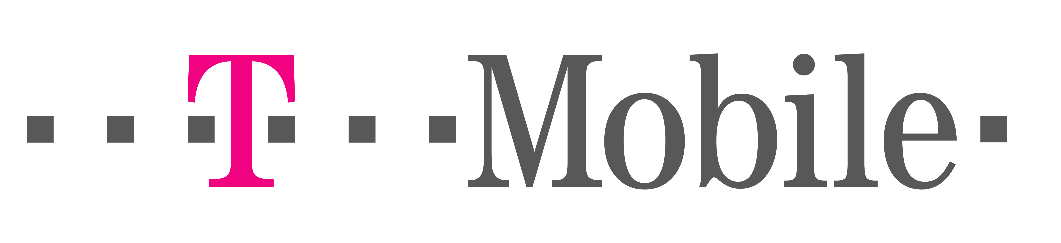

SimpliVity is a Proven Technology in Europe
Notes:
Sample customers
Best of VM – at VMworld out of 128 Manufacturers we won gold for storage and backup for virtualized environments
And just last December we won the Modern Infrastructure award at the Gartner conference… so focusing on the converge space we won top honors there as well.

Slide 10
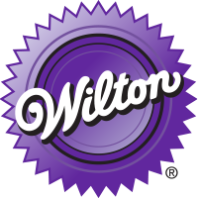
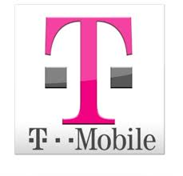






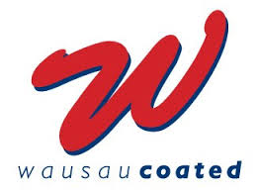




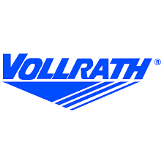

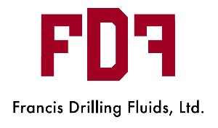

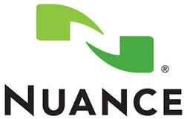
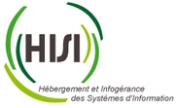



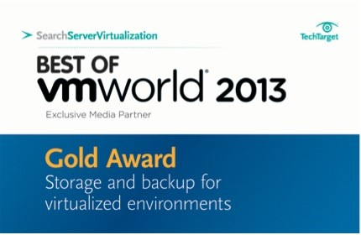
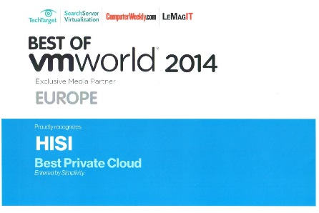


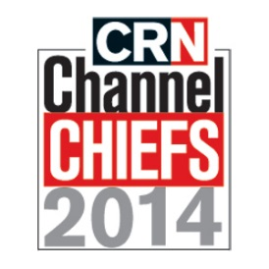
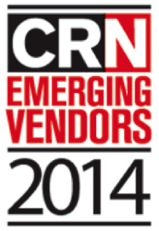
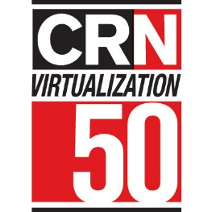
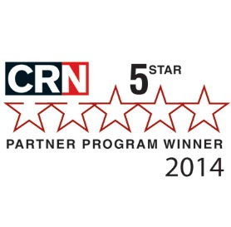
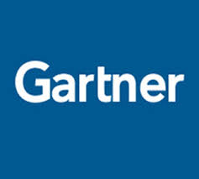
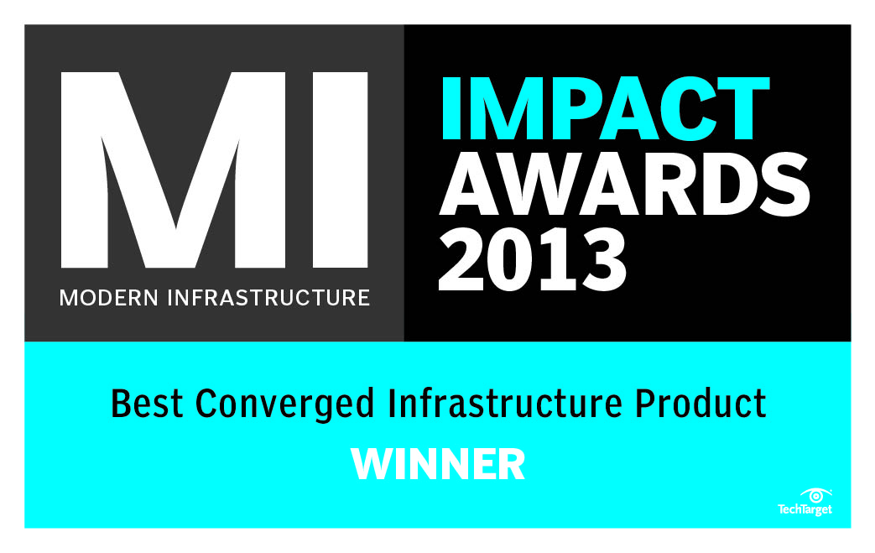
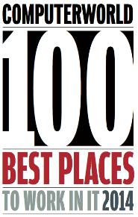
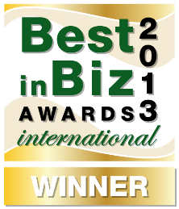
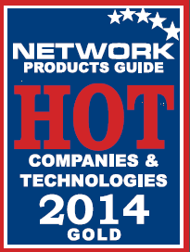
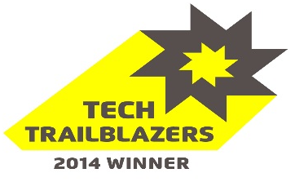
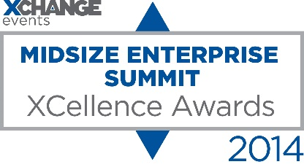
SimpliVity US Customers & Awards
Magic Quadrant
Visionary

Slide 11

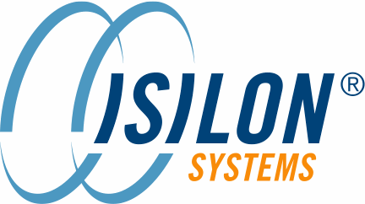


Momentum
First Three Years of Revenue
Calendar Years
Year 1
Year 2
Year 3
Simplivity
Nimble Storage
Isilon
Data Domain
EqualLogic
3 Par
2013: $1.5Bn Valuation at IPO
2006: $786MM Valuation at IPO
2010: Acquired by EMC for $2.25Bn
2007: $777MM Valuation at IPO
2009: Acquired by EMC for $2.1Bn
2008: Acquired by Dell for $1.4Bn
2007: $840MM Valuation at IPO
2010: Acquired by HP for $2.35Bn

Slide 12



SimpliVity Support Offerings
 | Silver | Gold
Deployment and Upgrade Support
24x7 Remote Monitoring and Repair
Onsite Response with Part Replacement | Next Business Day | 4 Hour
24x7 Global Technical Support
24x7 Access to Online Portal
Rights to download & upgrade new releases of software

Slide 13
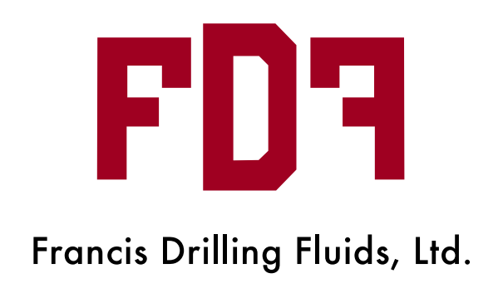
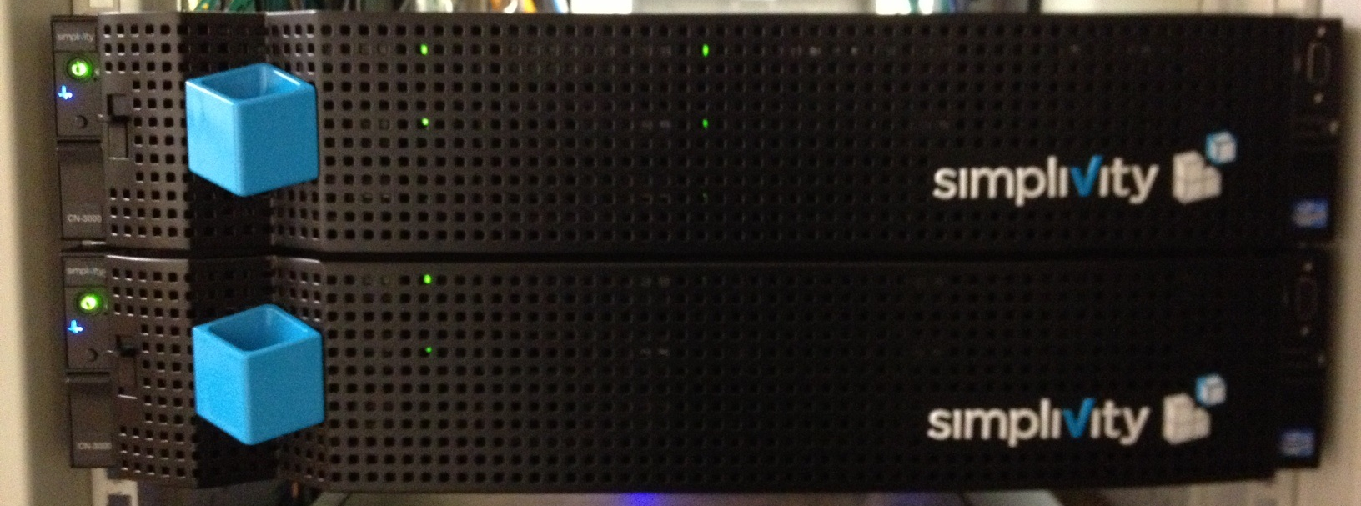
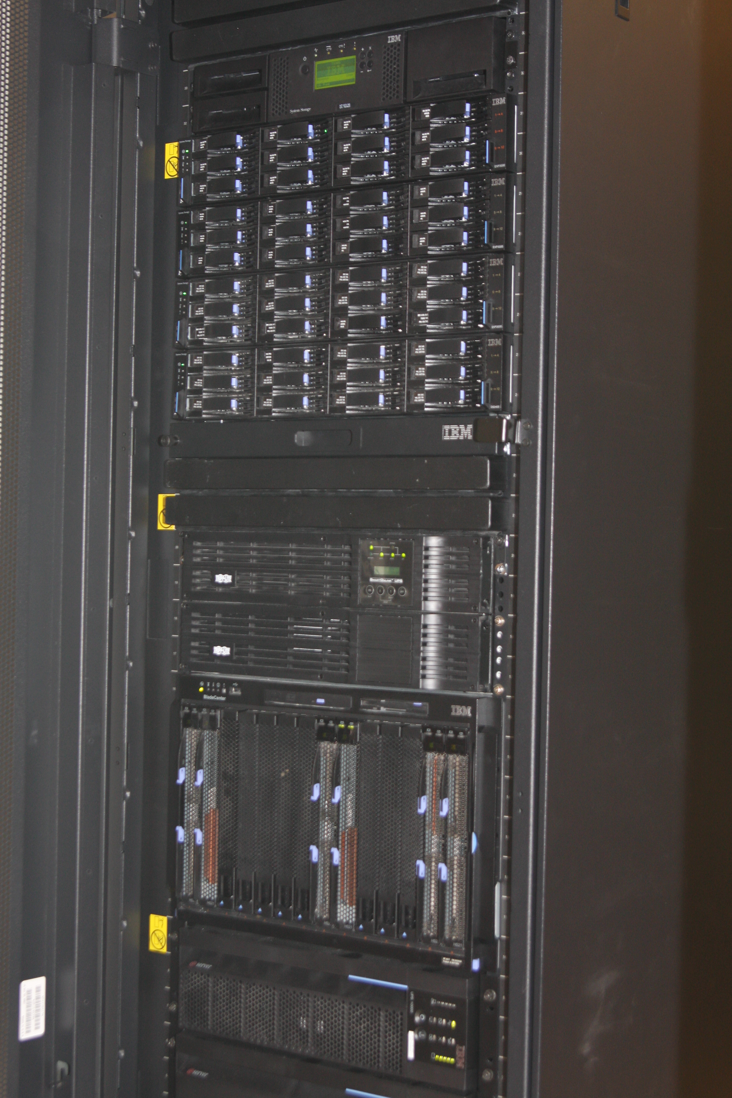
Real Case Study: Francis Drilling Fluids
IBM Tape Library
IBM Storage Array
After: 4U
2 OmniCubes in Lafayette, LA;
2 in Dallas Co-Location Facility
IBM Blade Server
&
IBM SAN
“OmniCube allowed us to radically simplify our
infrastructure. The solution provides superior value
and innovation in a converged solution.”
— Steve Schaaf, CIO
Chose SimpliVity over IBM, Nutanix
Before:
20U

Slide 14







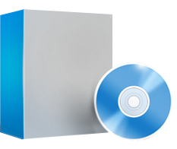

TCO Reduced by 396%
Servers + VMware
Storage switch
HA shared storage
SSD array
Storage caching
WAN optimization
Cloud gateway
Backup appliance
Data Protection
BEFORE $,000
CAPEX | $218
3 YR OPEX | $5181
TOTAL | $5399
AFTER (SVT) $,000
CAPEX | $302
3 YR OPEX | $1060
TOTAL | $1362
TCO Savings: 396%

Slide 15
Transparent Business Case for CIO & CFO
Redistribution of IT Budget

Slide 16
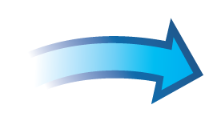



ROI – Translation of Technology into Economical Facts
Year :
WAN Optimization
(and storage again)
IT Infrastructure:
Avoid Capital Spend on Tech Refresh: Server, Storage, …. $
IT Operations:
Backup Faults Avoided (h)
Time Savings on DR Site (h)
Opportunity Cost - Time to Recover Data (h)
Training Requirement Reduction (h)
Consulting Cost Savings (h)
Vendor Consolidation - Management Savings (h)
Update / Patch Deployment Savings (h)
Business Implications:
Downtime Reduction (Unplanned & Planned) (h-> $)
IT User Waiting Time Avoided (min. -> $)
Year :
SAN Switch
(and servers again)
Year 2015:
Servers
Year :
Backup
Year 2016:
Storage

Slide 17






VM
VM
VM
Windows
Windows
VM
VM
Windows
linux
Windows
Windows
Windows
VM
VM
VM
Windows
VM
VM
Windows
VM
VM
VM
linux
Remote
Datacenter
Public Cloud
ESXi
ESXi
ESXi
ESXi
ESXi
ESXi
Local Storage
Local Storage
Local Storage
Local Storage
Local Storage
Local Storage
SSD
SSD
SSD
SSD
Data Protection Apps
SSD Cache
Data Protection Apps
Enterprise Capabilities
SSD Array
Cloud Gateway
Data Protection
Data Efficiency
Performance
Global Unified Management
Traditional Shared
Storage Array
Traditional Shared
Storage Array
SSD
SSD
SSD
SSD
Deduplicated
Disk Backup Appliance
WAN Optimization
Notes:
Key Points:
The legacy stack was designed over the period of 20 years, originally building for the peak levels of performance, accepting inefficiencies along the way
Each appliance was bought for very good reason, but each was designed to solve a different piece of the data’s lifecycle after the point at which it was created
There are about 9 different technologies that each perform a piece of data efficiency: dedupe and/or compression and those resources can’t be shared
But enterprises still require enterprise capabilities
Script
As virtualization expanded, and data demands grew, organizations had no choice but to use the legacy technology available and they kept adding more and more appliances and applications to solve the symptoms.
First, we had servers, each with their own application, OS and storage.
Question to ask the audience: who remembers these days?
Click:
Shared storage was the first wave of horizontal consolidation
Local storage islands were eliminated in favor of a centralized storage platform
This effectively virtualized the storage infrastructure and created a single shared resource pool
The result is improved utilization of the storage resources
Click:
VMware brought the second wave of horizontal consolidation
The CPU & memory resources in the infrastructure were turned into a shared resource pool
The utilization of the CPU & memory resources was improved
and servers were consolidated
Click:
Then as IT organizations grew and protection techniques evolved, remote sites were added and disaster recovery implemented.
Click:
Then starts the wave of appliance sprawl.
Appliances were added to solve point problems throughout the IT infrastructure
Each appliance requires training
Each appliance requires another GUI
Click:
1 – Storage array replication traffic uses a lot of network bandwidth, so WAN optimization appliances are added. These had deduplication, compression and optimization for the WAN.
Click:
2 – Deduplication backup appliances are added to keep backups on disk and improve backup and restore times. These had deduplication, compression and optimization for backup.
Click:
3 – Clouds are here to stay, so we have a new generation of cloud gateway appliances. These had deduplication, compression and optimization for the cloud. So, now we have 3 separate deduplication, compression and optimization appliances, each for their own piece of the stack, each trying to address a small symptom of the much larger problem.
Click x3:
4 – Flash technology has reached an inflection point where price, performance, capacity, and longevity have all aligned and it is being put everywhere. SSD arrays, SSD caches, SSD/PCIe in the hosts, and SSD in the arrays. And many of these have their own deduplication, compression and optimization as well.
Click:
And let’s not forget backup applications. Most organizations don’t just have one, but perhaps one for their tier 1, one for tier 2, one for VMs, etc.
The result is an environment that is very complex to manage. Many point solutions requiring specialized training and multiple management interfaces.
Click:
But at the same time, a lot of this has been necessary to date because the applications do require these enterprise capabilities:
Data protection
Data efficiency
Performance
Global unified management
These are must-haves in enterprise environments.

Slide 18




VM
VM
VM
VM
VM
VM
VM
VM
VM
VM
Public Cloud
Remote
Datacenter
ESXi
ESXi
ESXi
Local Storage
Local Storage
SVT
Local Storage
SSD
SSD
SSD
SSD
Data Protection Apps
VM
VM
VM
VM
VM
VM
VM
VM
SVT
VM
VM
SVT
SVT
Data Protection Apps
SSD Cache
ESXi
ESXi
ESXi
OmniCube
OmniCube
OmniCube
OmniCube
Cloud Gateway
SSD
SSD
SSD
SSD
SSD
SSD
SSD
SSD
SSD Array
Traditional Shared
Storage Array
Traditional Shared
Storage Array
SSD
SSD
SSD
SSD
Deduplicated
Disk Backup Appliance
Cloud Economics
Enterprise Capabilities
Data Protection
Data Efficiency
Performance
Global Unified Management
Low Cost
x86 Resources
Scale-out
The Best of
Both Worlds
WAN Optimization
Notes:
Key Points:
The OmniCube is a 2U building block of x86 resources
The OmniStack Accelerator deduplicates, compresses and optimizes all data inline in real-time at inception, once and forever, globally to provide incredible data efficiencies while increasing performance by offloading heavyweight operations from the Intel resources
When the OmniCube dedupes and compresses at inception, you no longer need the multitude of appliances to do it after the fact like WAN optimization or backup to disk appliances
With 2 nodes you get HA, with 3 you get scale-out, locally or globally or to the cloud
Script:
Click:
Let’s bring in those OmniCubes and see what happens
Click:
The first thing we do is bring in our OmniStack Accelerator Card. A PCIe card that plugs into the x86 server-based OmniCube, which deduplicates, compresses and optimizes all data at inception, once and forever across all stages of the data lifecycle, globally. This is the magic that sets us apart, providing incredible efficiency – up to 100:1 – while doing something no one else does: and that’s eliminating IOPS. When we dedupe and compress at inception, we physically dedupe the IOPS themselves. The fastest I/O is the one you never do. And when we bring in that capability a lot of really cool things start to naturally follow:
Click:
The first is that the SAN disappears. With SimpliVity, you don’t need a SAN. All storage functions are available within SimpliVity, but without any of the complexity. No more LUNs or RAID Groups or zoning or masking. All infrastructure is now at the VM level.
Click:
We store all data deduplicated, compressed and optimized, at inception, once and forever. This means it is always transferred over the WAN in a space efficient manner. So we don’t need these anymore.
Click:
We are able to take very space efficient backups, so there is no need to rehydrate the data to copy it to a disk based backup system and dedupe it – remember, we always do it inline, at inception, once and forever. Always.
The recovery time objective (RTO) is also very fast because the restore time is almost zero.
So we don’t need a separate device here either.
Click:
Or a separate application, It’s all built-in, at no extra charge.
Click:
Why would anyone want a separate appliance to connect to the cloud? It should be built into the device that manages the storage
We have that too.
Click:
we leverage flash technology very intelligently; Deduplication, compression, and the fine grained nature of our architecture mean we use both flash and DRAM very efficiently. So we don’t need a separate flash device.
Click:
One of the enterprise requirements is global unified management, so we connect all of our OmniCubes, globally, across the same network, what we call the Federation. It’s a simple scale-out, scale-in model where OmniCubes are added only as needed in a 2U form factor.
And our system is smart enough to understand a new location as a new location. You simply identify it as “London” or “San Francisco” for example, not be LUNs or Shares.
Click:
This may look like a next generation storage device. We have not stopped there. We run in conjunction with ESXi on the same platform. This allows the applications to run right next to the storage.
For all applications. Globally. Including the cloud.
Click:
This is the best of both worlds: providing cloud economics with enterprise capabilities.

Slide 19


Reduce Number of Devices in Your Data Center
>1/2 use at least
7
different devices before SimpliVity

Slide 20

Reduce Number of Management Panels in Your Data Center
75% used 4 or more interfaces prior to deploying SimpliVity hyperconverged infrastructure.

Slide 21

Simple Data Center = Faster Operations
Super fast training how to operate
Easy management through one vCenter console
Deployment of new services and applications reduced from days to hours
improved SLA for internal customers – reach functionality
Faster troubleshooting (x 8 on average)
Amazingly fast & simple scale-out = easy & quick budget planning

Slide 22

What Applications? Can I Run All IT on SImpliVity?
65% of our mid-market customers run 100% of their applications
on SimpliVity
Source: Internal SimpliVity analysis

Slide 23


When to Consider – Typical Use Cases
Remote Office Branch Office (ROBO)
1
Data Center Consolidation
6
2
Mission-Critical Applications
7
Data Protection
3
Continuous Data Monitoring / Analytics
8
Tech Refresh
4
Virtual Desktop Infrastructure (VDI)
9
Test / Dev / QA
5
10
Data Migration
Cloud

Slide 24

Typical Scenarios of Hyperconvergence Implementation
PHASE 1
PHASE 2
PHASE 3
Prove the value
Solve specific problems
Transform your data center
Improve operational efficiency
Revolutionize IT
3x TCO Savings
Degree of
Hyperconvergence
Increased Cost Savings
Starting
Use Cases
ROBO
Data Protection
Data Migration
Test & Dev
VDI
Consolidation
Data Center Consolidation
Mission-Critical Applications
100%
Applications
Cloud
Time

Slide 25

Implement True DR Functionality
70% implement “sub-par” DR strategy prior to hyperconvergence

Slide 26



Implement Native - Automated Data Protection
Easily see all backups
“SimpliVity has made great progress during
2013, and offers an even
more radical integration
story that extends to deduplication and negates
the need for WAN optimization.”
– Gartner
Easily set backup rules
Single Interface:
  Provisioning VMs
  Protecting VMs
  Restoring VM
  Restarting VMs in DR
  Cataloguing backups
One-click:
  Backup
  Clone
  Move
  At VM-level granularity!

Slide 27


Simplify the Buying Cycle
Challenges
Never-Ending Refresh Cycle
Migrations are expensive: about 17% of the total cost of a storage array
Budgets are flat
Each Technology
has its own:
  Management
  Training
  Maintenance
  Support
  Operational Expense
Predictions of future growth have been
far from accurate
Solution
SimpliVity OmniCube
Break the
buying cycle
with SimpliVity
Enable continuous change without the impact
Scale-out/in: buy what you need when you need it
One vendor
Reallocate time and resources towards innovation and productivity
WAN Optimization
(and storage again)
SAN Switch
(and servers again)
Servers
Backup
Storage

Slide 28
Increase the Application Performance
SimpliVity Provides Dramatic
Application Performance Improvements
>1/2 see
>50% Performance Improvements
Greater than 75%: 17%
50% to 75%: 33%
25% to 50%: 38%
Up to 25%: 12%
SimpliVity Provides Dramatic
Application Performance Improvements
Since deploying SimpliVity, how much have you improved
or do you expect to improve performance?
90% experience >25% performance improvement
with dedupe & compression
greater efficiency
with SimpliVity
Greater than 75%: 17%
50% to 75%: 33%
25% to 50%: 38%
Up to 25%: 12%

Slide 29

Accelerate Deployments
Before SimpliVity:
17%
could deploy in one day
After SimpliVity:
74%
17%
54%
23%
6%
74%
21%
4%
1%

Slide 30
HyperConverged Architecture Makes IT Life Easier
Native HA architecture with immediate DR functionality (2+1)
Native backup with reach functionality (no additional devices) also in remote sites on production environment
Significant application performance improvement (increased IOPS)
Guaranteed 10:1 storage savings
WAN performance – problems solved
TCO savings up to 300% in 3-5 years (individual analysis on request)

Slide 31

SimpliVity HyperGuarantee
The Industry’s Most Complete Guarantee
HyperEfficient | 90% capacity savings across all of your storage including backup.
HyperProtected | 60-seconds or less on average for local backup or restore a 1 TB VM.
HyperSimple | 3 clicks to backup, restore, clone or move a VM from a single console.
HyperManageable | 60-seconds or less on average to create or update backup policies for 1000s of VMs across dozens of remote sites from a single console.
HyperAvailable | Add or remove a local or remote SimpliVity system without downtime, without interruption to local or remote backups, and without reconfiguration of backup policies or IP addresses

Slide 32
Summary: How to Start My HC Journey?
Does HC fit to my applications, workloads, scale? Architecture workshop
How much is it ? Sizing workshop => Budget proposal
Does it fit budget? TCO analysis & Financing options
How to make sure it works? POC: cloud or on-site
Internal documentation? Ask – we will deliver
OurSpace – We work as a Team

Slide 33
Thank You

Slide 34
HyperGuarantee = HyperEfficient
Using SimpliVity hyperconverged infrastructure with built-in VM-centric backup capability as outlined, you will save 90% capacity, across storage and backup combined, relative to comparable traditional solutions
  This assumes that you configure a backup policy to take at least one SimpliVity backup per day of every VM on every SimpliVity system in a given VMware Datacenter with those backups retained for 30 days
    If backups are performed more frequently and/or retained for a longer period, you will enjoy even greater efficiency.
    The data change rate is assumed to be up to 5% per day with up to 30% growth rate of the data over a duration of 30 contiguous days.
  B. 90% savings is the equivalent of 10:1 efficiency in the Datacenter panel in SimpliVity tab within vSphere Client.
  C. Efficiency is calculated across all SimpliVity systems in a VMware Datacenter
    “Efficiency”: the ratio of storage capacity that would have been used on a comparable traditional storage solution to the physical storage that is actually used in the SimpliVity hyperconverged infrastructure.
    “Comparable storage solutions”: storage systems that provide VM-level synchronous replication for storage and backup and do not include any deduplication or compression capability.

Slide 35

HyperGuarantee = HyperProtected
If you use SimpliVity’s hyperconverged infrastructure and its built-in backup capability, it will take less than 1 minute*, on average, to complete a local backup or local restore of a 1TB VM.
  *Time taken by applications to quiesce data is not included in the 1 minute because it is not in SimpliVity’s control.

Slide 36

HyperGuarantee = HyperSimple
Using SimpliVity’s user interface, which is fully integrated with VMware vCenter, you only need 3 clicks* to Backup, Restore, Move, or Clone a VM, all from a single console.
*This assumes that the user is starting from the view tab in the interface that shows the VMs or backups that are being acted on. Changing default destinations are not counted in the 3 clicks.

Slide 37

HyperGuarantee = HyperManageable
Using SimpliVity’s user interface in central location, in less than a minute on average, you will be able to create or update backup policies for thousands of VMs across dozens of sites.

Slide 38

HyperGuarantee = HyperAvailable
You will be able to add or replace SimpliVity OmniStack systems:
  Without any downtime for local or remote sites
  Without any disruption to local or remote SimpliVity backups
  Without any reconfiguration SimpliVity backup policies for local or remote sites
  Without the need to re-enter any IP addresses in remote sites

Slide 39
No Gimmicks
The 5 SimpliVity HyperGuarantees are available to all customers who:
Use SimpliVity OmniStack version 3.0 or higher and
Are Covered under the standard SimpliVity product warranty
  The SimpliVity product warranty is valid for 90 days after delivery of the product to the customer
  The warranty is described in the SimpliVity End User License Agreement: https://www.simplivity.com/eula.
  Customers must register for the warranty at http://www.simplivity.com/support at any time during the warranty period

