Slide 1
Flash Storage v vsako slovensko vas
Matej Moškon
Notes:
1

Slide 2
Notes:
2

Slide 3
Instant info
Prvi sistem pred 3 leti
+90% novih sistemov s Flash tehnologijo
Autotiering is dead
210⁺
~200
Flash PB
Flash-related patents
100%
80.000⁺
4.700+
Letni prirastek (PB)
Hybrid controllers
All-flash controllers
Notes:
3

Slide 4
Paleta opzimizacij
Deduplikacija
Kompresija
Wearing
Trimming
Optimizacija branja
8.2.x
8.3
8.3.1
request
response
Network
Network
Network
WAFL
WAFL
WAFL
RAID
RAID
RAID
Storage
Storage
Storage
Notes:
4
8.3
Read responses are passed directly from RAID to Network – bypassing WAFL – as long as no errors are detected. When an error is detected, the WAFL code must get involved
8.3.1
Read requests are passed directly from WAFL to Storage, bypassing RAID.
Read responses are passed directly from Storage to Network, bypassing both RAID and WAFL, unless error recovery is required.

Slide 5
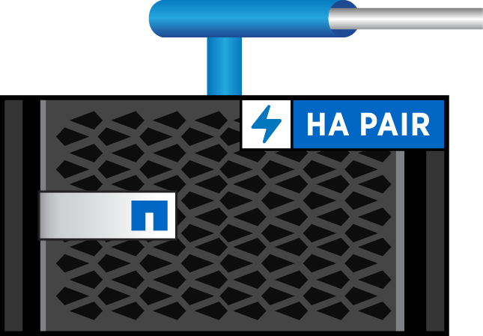
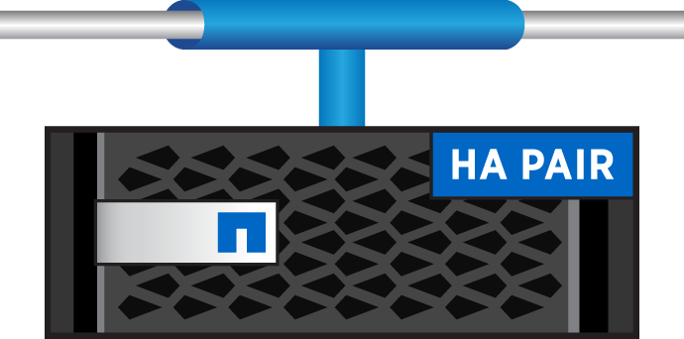
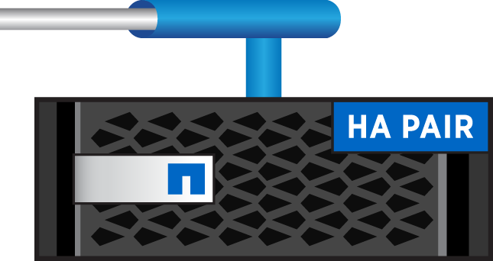
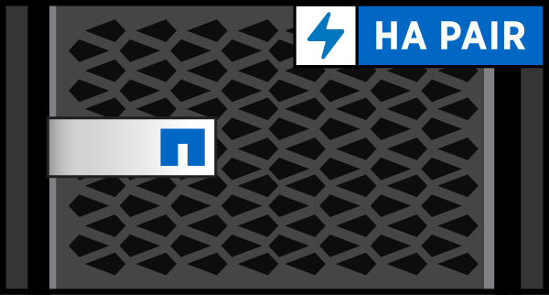
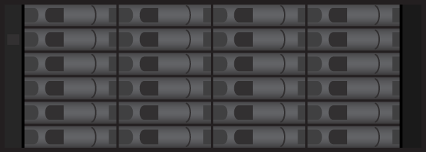
FAS/AFF družina
Protocols
FC
FCoE
iSCSI
NFS/pNFS
CIFS/SMB
All Flash
All Flash and Hybrid Flash/ HDD
Poenoteno upravljanje
Scale-out, brezprekinitveni posegi
Mobilnost podatkov znotraj clustra
Zaščita podatkov (Snapshots, SnapMirror, SnapVault)
Storage efficiencies
Integracija z apliakcijami
Secure multi-tenancy, QOS
Notes:
5
In the absence of a mechanical failure, rotating media can serve data almost indefinitely. This is not true for SSDs, which can accept only a finite (though very large) number of write operations. SSDs provide a set of internal spare capacity, called spare blocks, that can be used to replace blocks that have reached their write operation limit. After all of the spare blocks have been used, the next block that reaches its limit causes the disk to fail.
Because a drive failure is an undesirable occurrence, Data ONTAP replaces SSDs before they reach their limit. When a predetermined percentage of the spare blocks have been used (approximately 90%), Data ONTAP performs the following actions:Sends an AutoSupport message.
If a spare SSD is available, starts a disk copy to that spare.
If no spare is available, starts a periodic check for a spare so that the disk copy can be started when a spare becomes available.
When the disk copy finishes, fails the disk.

Slide 6
EF družina
Vrhunske zmogljivosti za občutljive podatke glede odzivnosti
Arhitektura, načrtovana za I/O z majhnimi zakasnitvami
Sprejemljiv kompromis med IOPS in pretočnostjo
Kompaktnost opreme glede na IOPS
Redundanca + zmogljivost = 2U sistem
Zmogljivost enaka +1.000 HDDs
Zmagovalec pod obremenitvami podatkovnih baz
> 99.999% razpoložljivost
Podatki so vedno na voljo, zaščiteni in varni
Notes:
6

Slide 7
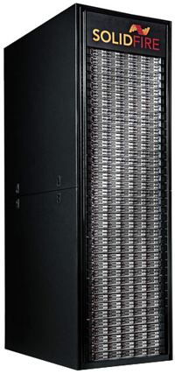
Solid Fire
10Gbit back end komunikacija
Poudarek na skalabilnosti
Data protection – mirroring data between nodes
Vsak node je sestavljen iz 10 MLC flash SSD modulov
Poudarek na cloud arhitekturi
Notes:
7

Slide 8
Kaj izbrati?
Notes:
8

Slide 9
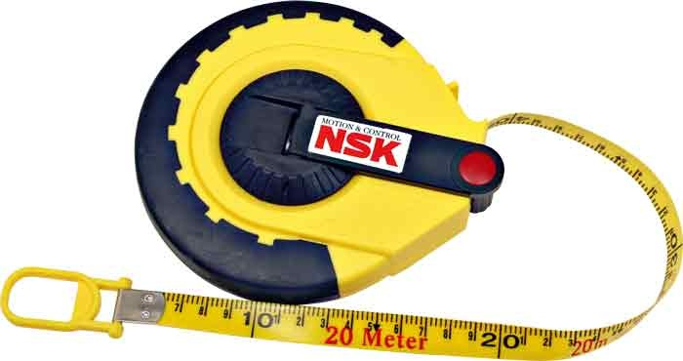
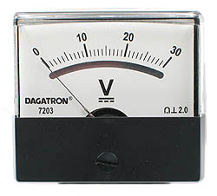
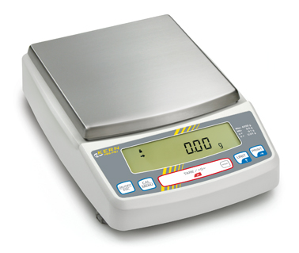
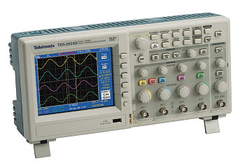
Vhodni parametri
Velikost blokov
Sequential vs random read
Read / write razmerje
Pretočnost
Latency
IOPS
Tip aplikacije
Notes:
9

Slide 10
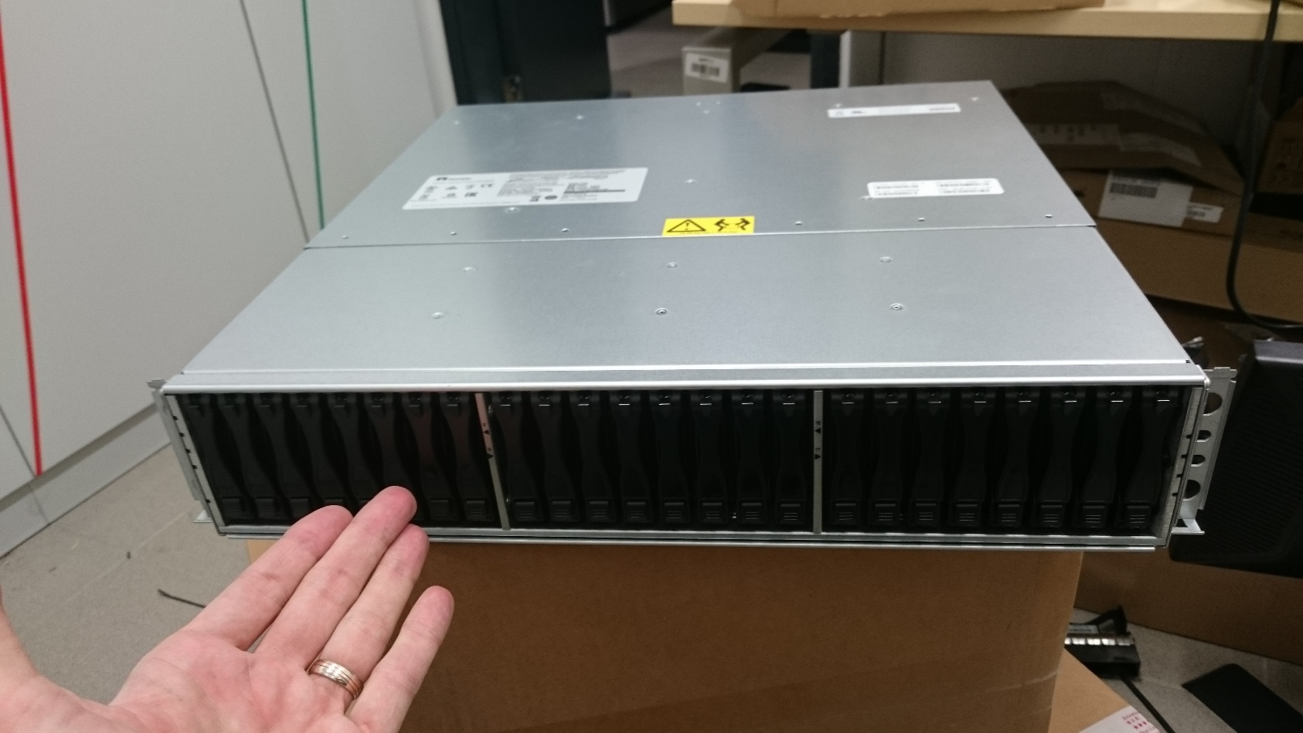
Primer iz prakse
Notes:
10

