Slide 1
Splunk> Enterprise security
Our Space Appliances

Slide 2
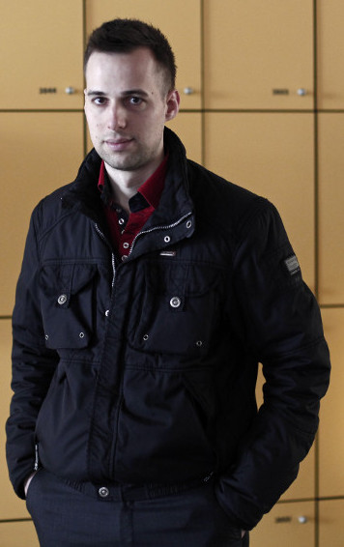
Sveže kot žemljice pri peku
Portal RTVSLO.si 17.6.2016 7:52
Informator policije Dejan Ornig … je med decembrom 2012 in majem 2015 v dogovoru z dvema kriminalistoma vdiral v elektronsko pošto in preostalo spletno komunikacijo več kot 300 ljudi, ki so se njemu ali policiji zdeli sumljivi.
Za to početje naj bi vedeli tudi vodilni v policiji … Priznavajo da je bil v zvezi s tem že pred časom na policiji odrejen strokovni nadzor, ki pa razen neprimerne komunikacije kriminalista po elektronski pošti ni potrdil tovrstnih navedb.

Slide 3
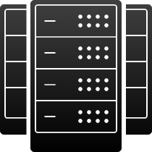
Napredne grožnje težko odkrijemo
100% Uporaba veljavnih poverilnic
Spletni kriminal
40
Povprečno št. napadenih sistemov.
Države
229 Dni do odkritja
67%
Organizacij je bilo o napadu obveščenih od zunaj.
Notranje grožnje
Vir: Mandiant M-Trends Report 2012/2013/2014
Notes:
DEJAN ORNIG
The number of threats is increasing and also becoming more advanced. Today’s advanced threats are stealthy and sophisticated and evade detection from traditional, point security products that look for specific threat signatures. Above are 3 types of advanced threats. They are good at stealing confidential data, whether it be credit cards or IP, and many of their victims unfortunately end up in the headlines.
Cyber criminals include the credit card theft at Target and Neiman Marcus. Nation state attacks include Iran, China and North Korea attacking governments and private sector companies to steal intellectual property and/or national secrets.
FYI these advanced threats are also commonly called APTs, or Advanced Persistent Threats.
APT are hard to detect because they are not signature-based and hide behind legitimate credentialed activity to evade detection from traditional, point security products. Every year companies like Mandiant produce reports that describe the trends identified based on the breach investigation work that they do as part of their consulting practices. There are a couple metrics that I found interesting reading their recent reports.
100% is often via stealing password hashes or using keyloggers. Often they steal admin-level credentials so they can access many other systems and not be detected.
The 40 implies that even if you see malware in one place, you need to look much further as there are likely multiple infected machines and backdoors
243 days shows how they can evade detection for months at a time. They move slow and low and do not set off alarms from point, signature-based security products like anti-malware solutions.
63% of victims were notified by an external entity. Notification usually starts with customer complaints like bank account drained or credit card maxed out. Often FBI informs them.

Slide 4
Novi pristopi
GROŽNJE
Napadi
Varnost?
Kombinacija ljudi, procesov in tehnologije.
Okolje in obnašanje.
Hitro učenje in odzivi.
Deljenje informacij in sodelovanje.
Vsi podatki so lahko relevantni.
Uporaba virov znanja (treat intelligence).
Upravljajo jih ljudje
Ciljno orientirani
Spremenljivi
Koordinirani
Različna orodja in aktivnosti
Nove tehnike
LJUDJE
PROCESI
TEHNOLOGIJA
4

Slide 5
Varnost in skladnost
Cilji
Prednosti Splunka
Zaščititi organizacijo pred
Razkritjem informacij
Malware
Zlorabe
Kraja intelektualne lastnine
Skladnost z revizorskimi zahtevami.
Doseganje transparentnosti
izboljšanje pri odkrivanju in raziskovanju dogodkov.
zmanjšanje časa, potrebnega za raziskovanje incidentov.
znižanje tveganj povezanih z razkritjem informacij, zlorabami in krajami intelektualne lastnine.
znižanje dela, potrebnega za skladnost z zahtevami revizije.

Slide 6
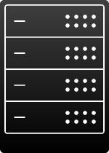
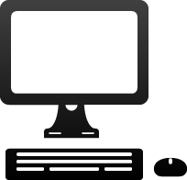
Primer aktivnosti APT
Prenos
Pridobitev dostopa
do sistema
Sprememba okolja
Oškodovanje
organizacije
Napad spletne strani
Kraja .pdf datotek
Spletni
portal
Upravljanje na
daljavo, kraja
Podatkov,
botnet
Threat intelligence
.pdf
Mrežna aktivnost varnost
Napadalec pripravi malware, vključi v .pdf,
Pošlje povezavo
preko emaila
Komunikacija z strežnikom za upravljanje preko HTTP protokola.
WEB
MAIL
Prebere email, odpre .pdf
Gostiteljeva aktivnost/varnost
odpremo .pdf, razpakira se malware,
Ki zamenja delujoče in dovoljene aplikacije.
Uporabniške vloge
.pdf
Calc.exe
Svchost.exe
Notes:
ZEUS: odkrit leta 2007, da bi ukradli podatke US Department of Transport. Uporabljen tudi za nameščanje CRPYTOLOCKER ransomware-a.
Use the animation to talk to the Zeus attack scenario described in the Zeus demo.
Reconn – find vulnerability, find method most likely to gain access – locate vulnerable server with .pdf
Reconn - Attacker attacks an extranet portal (vulnerable server) and steals a known good document (.pdf)
Weaponization - Attacker creates malware and packages up in pdf and names it the same document as that on the portal (look like a good document)
Delivery - Attacker spoofs (use technique to send email that looks like it’s coming from an employee of the company) a company employee email and sends to several targets at the company
Exploitation – User (all it takes is one) reads email, open the attachment, exploits a vulnerable in a document reader that allows programs to run
Installation – program installs several programs that over-write “good” programs on the computer – the calculator program – calc.exe
Installation – calc.exe spans svchost.exe, a generic program on windows machines
Command and Control – svchost.exe establishes communication to remote command and control server.
Point out – this came from a real example. The left shows the different defensive technologies that might have seen something.

Slide 7
Uporaba Splunka za povezovanje virov
IP-ji na seznamu TI
Zlonamerna komunikacija
prenos
Malware
Malware izvršen in nameščen
Notes:
Looked at in a slightly different manner, the Splunk user will link the different events together to determine if their organization is being attacked. In this example some of the events they can link together might be the malware delivery or download (as seen by the email or web device), the malware execution and installation (as seen by the endpoint device) and then the malicious communication between the infected endpoint device talking to the attacker (as seen by the network devices – either web, firewall, wire data device, etc.). Notice the malicious communication might have been detected by the security device or by anomaly detection or by matching the destination traffic to some black list of known attacker destination IP address. Any one of these events/activities would be captured by security/infrastructure devices that would be the definitive record of the attack.
The security analysts is looking for related events & activities, to determine the scope of the attack, look for other victim or additional compromised host, what the attacker or malware is trying to do.

Slide 8
Kako odkriti izvor?
Prenos
Pridobitev dostopa
do sistema
Sprememba okolja
Oškodovanje
organizacije
Spletni Portal
Threat intelligence
.pdf
Mrežna aktivnost varnost
MAIL
Proxy log C2 komunikacija
na črni listi
WEB
Dogodki, ki vsebujejo
Povezavo do datotek
Gostiteljeva aktivnost/varnost
Kaj je ustvarilo program/proces?
Kako se je proces zagnal?
Command and control (C2) traffic
Uporabniške vloge
.pdf
Calc.exe
Svchost.exe
Notes:
This animation shows how the attack is traced back to the root.

Slide 9
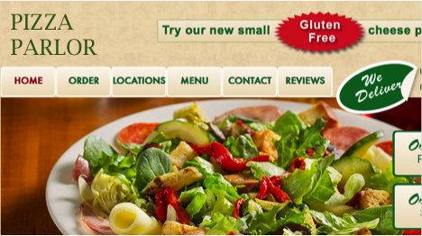
Kaj moramo spremljati, da bi videli celoto
Dostava
Raziskovanje in namestitev
Upravljanje in kontrola
Doseg cilja
1
Threat Intelligence podatki
Threat intelligence
Threat Intelligence podatki
Email
Ali
Spletni strežnik/proxy
Download from infected site
2
MAIL
WEB
WEB
FW
Mrežna aktivnost varnost
Proxy podatki ali požarni zid
7
8
phishing
6
Podatki o napravi
ali
endpoint protection
Gostiteljeva aktivnost/varnost
3
4
5
Uporabniške vloge
Identity, Roles, Privileges, Location, Behavior, Risk, Audit scope, Classification, etc.
Podatki o identiteti

Slide 10
Zaposleni, ki zapuščajo organizacijo.
Namerna očrnitev organizacije z objavo zaupnih podatkov.
Nameren napad na podjetje.
Neizobraženost uporabnikov.
NOTRANJE GROŽNJE
10
Notes:
To niso hekerji.
Lahko nenamensko: Kraja laptopa, pošiljanje maila napačni osebi.
Motivacija:
Zaposleni ki zapuščajo podjetje:
Grejo h konkurenci in tja prenesejo tudi podatke o strankah – velika poslovna škoda
Seznami sumljivih uporabnikov, katere je treba pozorneje spremljati.
DLP – delno učinkovito
FBI: 90% IT sabotaž so pozvročili sistemski administratorji
Problem predstavljajo tudi pogodbeni sodelavci.

Slide 11
… kot platforma za varnost
Splunk je lahko več kot le SIEM
Raziskovanje
In analiziranje incidentov
Poročanje o varnosti in skladnosti
Spremljanje
Znanih groženj
V realnem času
Zaznavanje
Neznanih
groženj
Zaznavanje
zlorab
Notranje grožnje
Notes:
Splunk is a Security Intelligence Platform and we can address a number of security use cases. We’re more flexible than a SIEM and can be used for non-security use cases. Splunk software can complement or replace existing SIEM deployments, while also addressing more complex security use cases, such as supporting fraud detection and finding insider threats.

Slide 12
Splunk Enterprise Security
Analize na podlagi rizika
Vizualizacija in iskanje odvisnosti
Obogatitev analiz s „Threat Intelligence“ podatki
Notes:
Risk-Based Analytics to Align Security Operations With the Business
Risk scoring framework enhances decision making by applying risk scores to any data
Quickly and easily assign any KSI or KPI to any event to align with your current priorities
Expose the contributing factors of a risk score for deeper insights
Visualize and Discover Relationships for Faster Detection and Investigation
Visually fuse data, context and threat-intel across the stack and time to discern relationships
Pre-built correlations, alerts and dashboards for detection, investigation and compliance
Workflow actions and automated lookups enhance context building
Enrich Security Analysis with Threat Intelligence
Automatically apply threat intelligence from any number of providers
Apply threat intelligence to event data as well as wire data
Conduct historical analysis using new threat intelligence across all data

Slide 13
Demonstracija
Notes:
Risk-Based Analytics to Align Security Operations With the Business
Risk scoring framework enhances decision making by applying risk scores to any data
Quickly and easily assign any KSI or KPI to any event to align with your current priorities
Expose the contributing factors of a risk score for deeper insights
Visualize and Discover Relationships for Faster Detection and Investigation
Visually fuse data, context and threat-intel across the stack and time to discern relationships
Pre-built correlations, alerts and dashboards for detection, investigation and compliance
Workflow actions and automated lookups enhance context building
Enrich Security Analysis with Threat Intelligence
Automatically apply threat intelligence from any number of providers
Apply threat intelligence to event data as well as wire data
Conduct historical analysis using new threat intelligence across all data

Slide 14
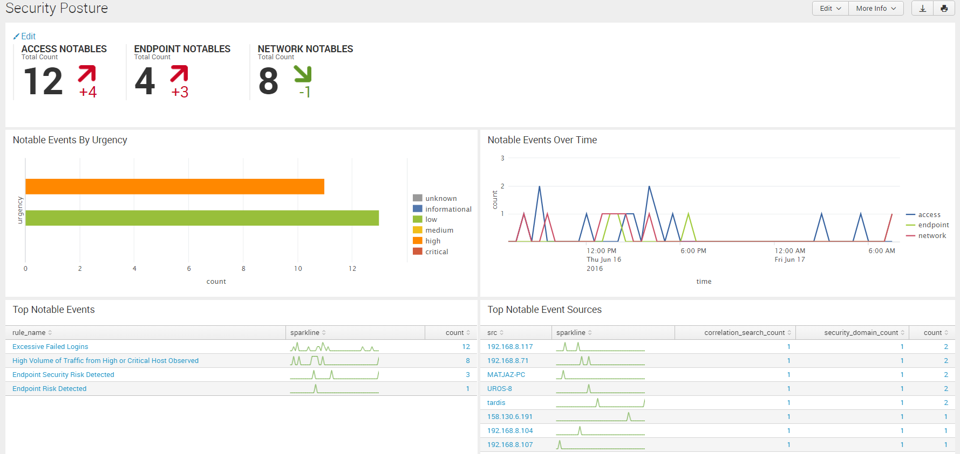

Slide 15
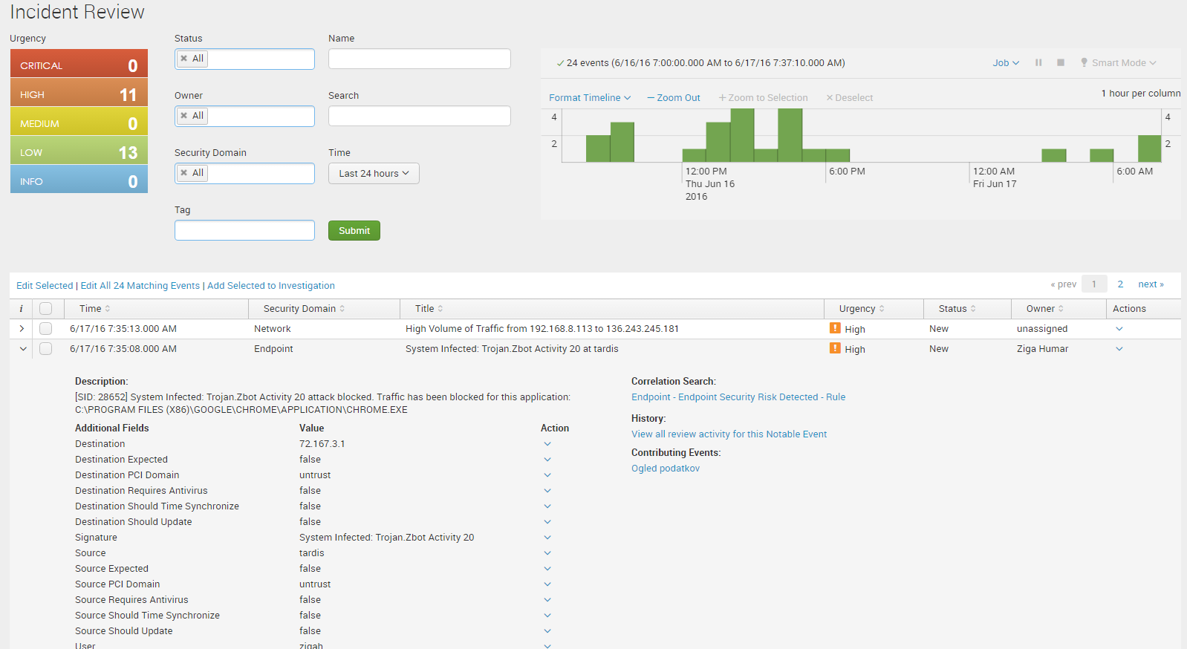

Slide 16
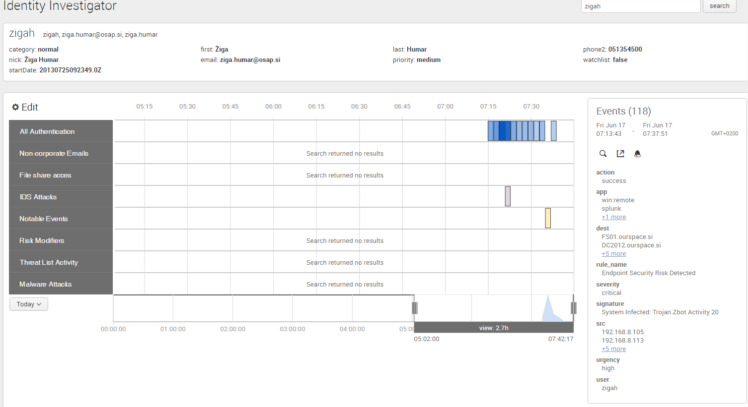

Slide 17
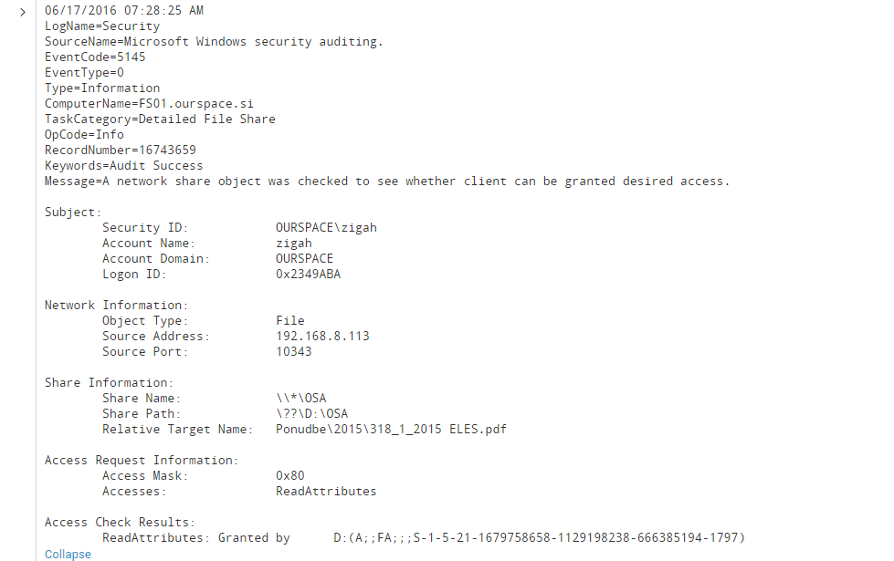

Slide 18
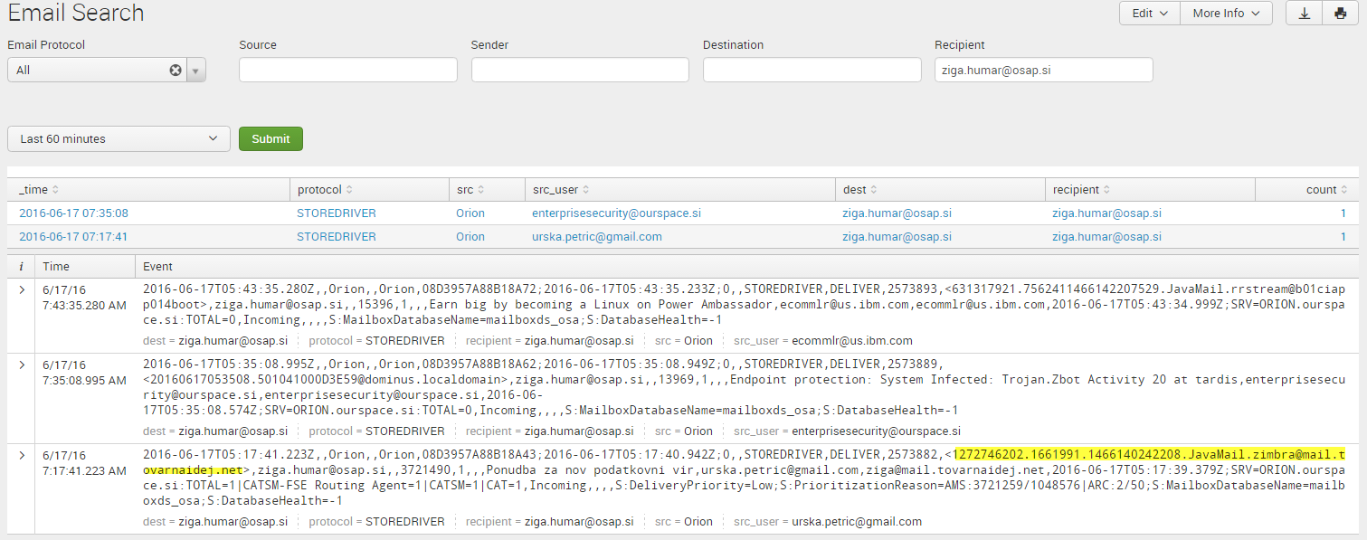

Slide 19
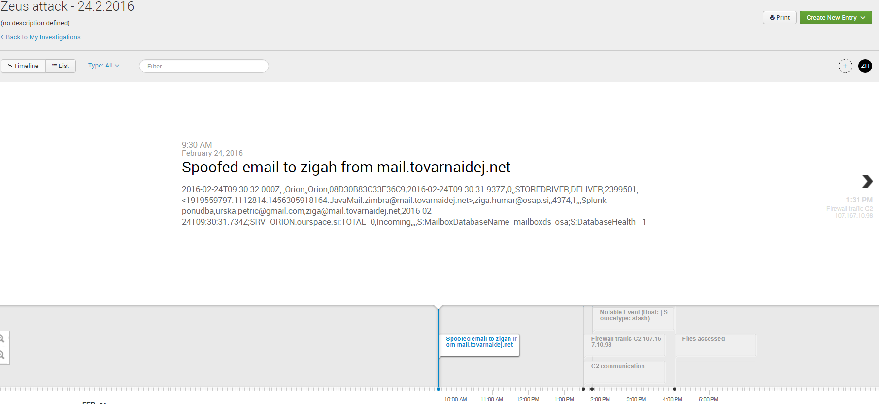

Slide 20
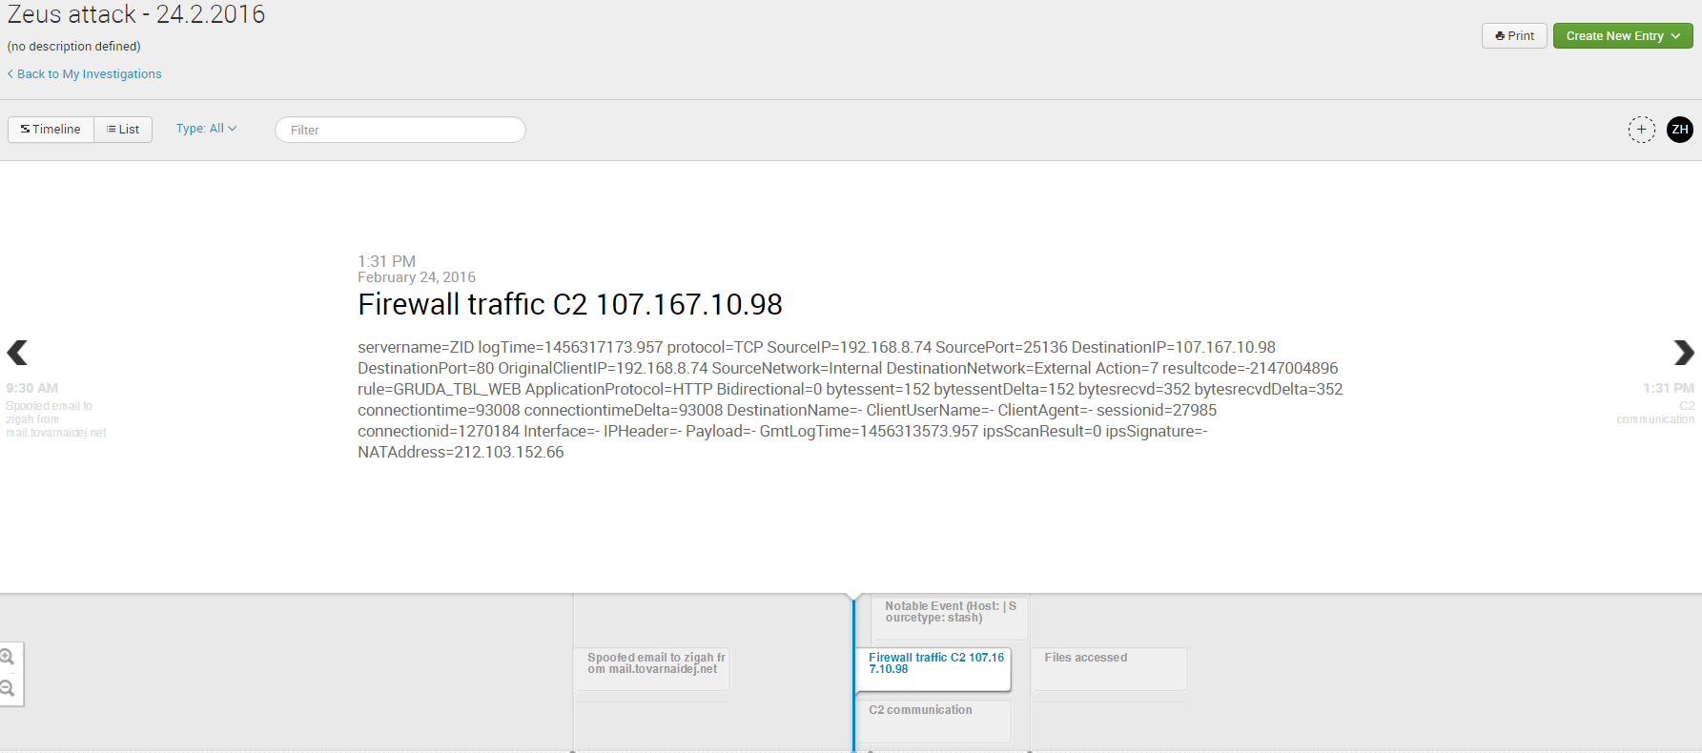

Slide 21
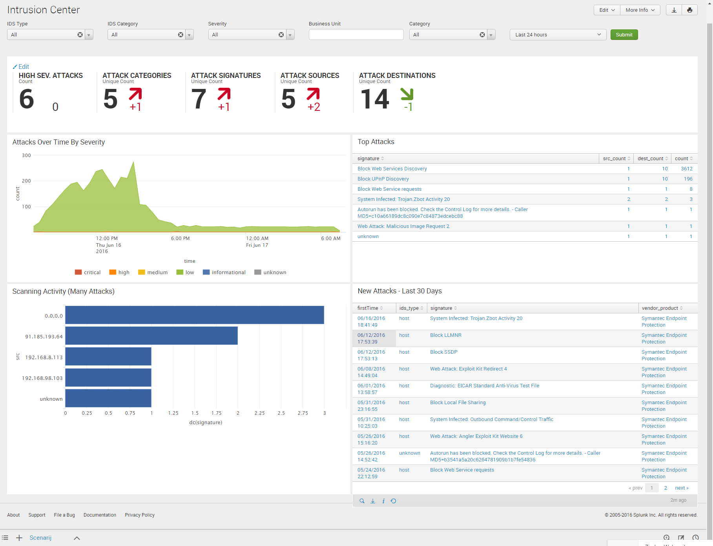

Slide 22
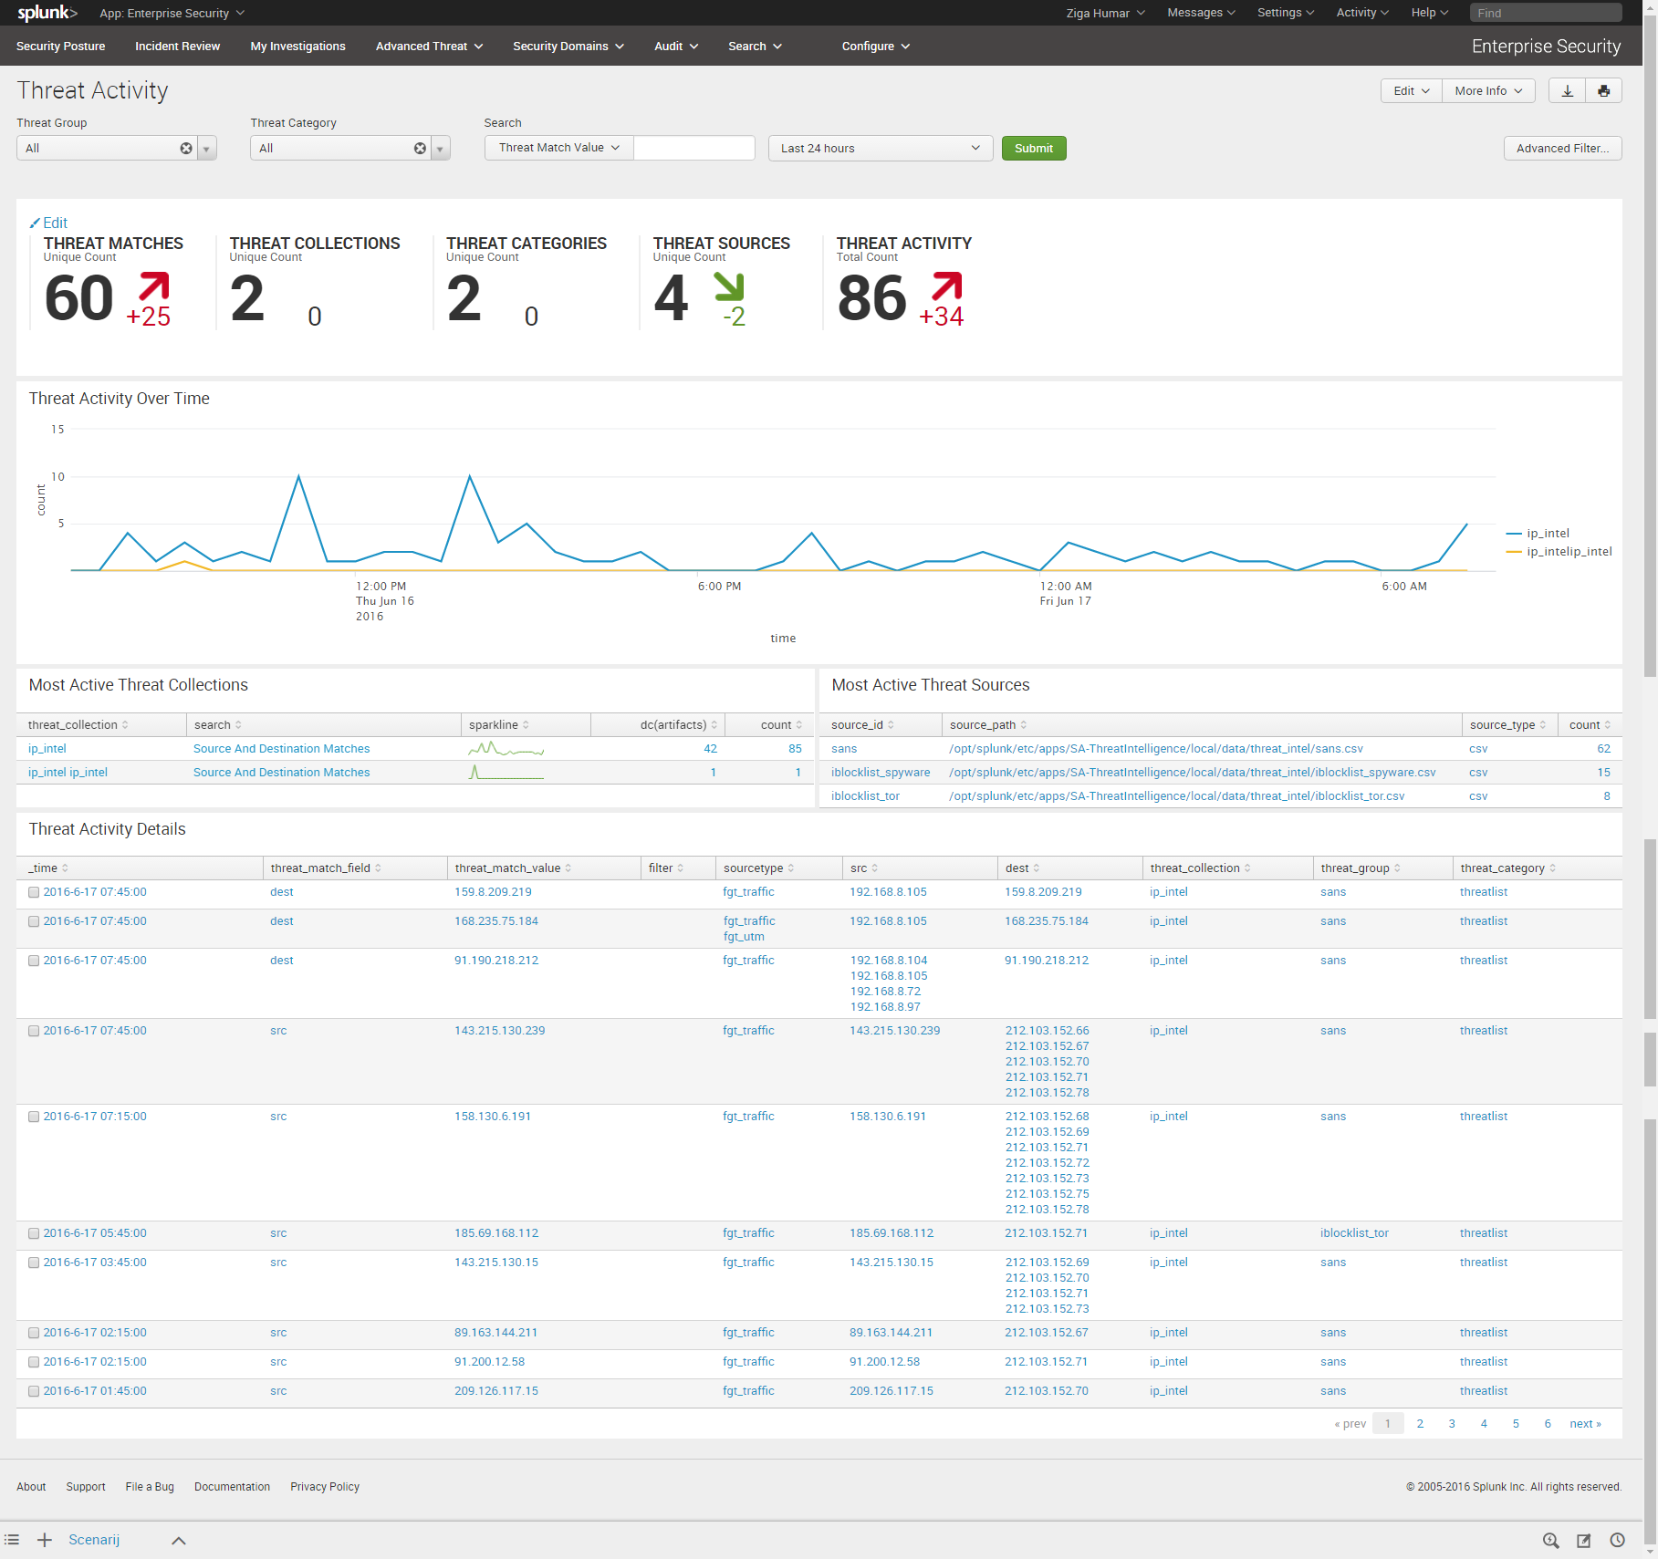

Slide 23
Omejitve obstoječih SIEM
Omejen pogled v varnostne grožnje. Otežkočeno zbiranje varnostnih podatkov; dragi agenti za zbiranje; potreba po definiranju shem.
Neprilagodljiva iskanja in izdelava poročil ter obveščanje o napakah.
Omejena skalabilnost onemogoča Big data analitiko
Težavna namestitev in upravljanje. Velikokrat skupek različnih produktov.
Notes:
Here is why SIEMs are not catching the advanced threats and not generating value in general. (A later slide has more detail on Splunk points of differentiation. )
For point 1, traditional SIEMs suffer from:
Collectors or backend database require data reduction or normalization – hampers security use cases
Little support for custom data sources
Brittle collectors break when data format changes
Clock icon indicates slow searches and long time to deploy. Dollar sign is the expensive costs behind the long deployment (lots of prof serv) and multiple products.

Slide 24
Splunk
Lahko zajame vse tekstovne vire
Možno iskanje po vseh zajetih virih
Big data arhitektura, ki omogoča skalabilnost in hitrost
Fleksibilnost iskanj in poročil omogoča hitrejše in boljše raziskovanje groženj in napadov
$
En produkt, grafični vmesnik in podatkovna zbirke
Programska oprema, ki teče na strežnikih
Hitra postavitev + enostavnost uporabe = hiter time-to-value
Odprtost platforme z API, SDK in aplikacijami.
Uporaben tudi zunaj področja varnosti.

Slide 25
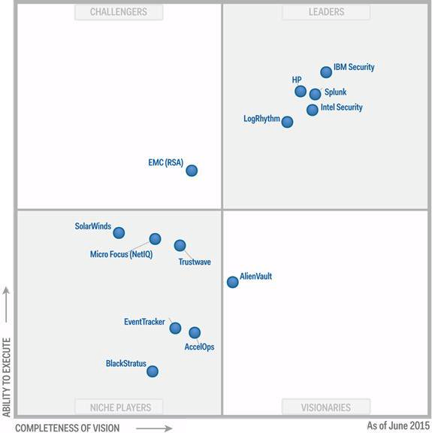
ES v družbi najboljših
2015
2015 Vodja – edini ki je izboljšal
Vizionarsko pozicijo
2014 Vodja
2013 Vodja
2012 Izzivalec
2011 Nišni igralec
Notes:
Our rapid ascent reflects the customer traction we have and value we deliver to customers – with thousands of security customers and 40% year-over-year growth, we are the fastest growing SIEM vendor in the market. 2011 was our first time in the MQ; In 2 short years we raced up to the top quadrant in the MQ.

Slide 26
Ne pozabimo
SIEM je proces in ne produkt.
Ni le skupek programske in strojne opreme.
Spremljanje sprememb, stalno spremljanje varnostnih priporočil.
Posodabljanje seznamov virov (kadri, naprave)
Potrebuje dediciranega in vestnega varnostnega inženirja.
26
Notes:
Let’s start with today’s ever changing threat landscape:
With all the news on cyber attacks and security breaches, you know we are constantly up against 3 very sophisticated adversaries:
the cyber criminals,
the nation states
and also the malicious Insiders;
All going after major stakes of our life, our company and our nation.

Slide 27
Pa smo prileteli do konca…
Hvala za vašo pozornost!
www.osap.si/anketa
Notes:
MIKROCOP ZGODBA:
Začeli kot siem, ampak stvar prerasla v veliko več. Sedaj imajo dostop do njih tudi razvijalci. Obveščanje o napakah v kritičnih servisih…

